Slide 1




Hiring Individuals with Disabilities
Disability Inclusion & Best Practices
for the Employee Lifecycle

Slide 2
Hiring: Strategies for Inclusion
Ensure that application forms, application tracking systems, employment offices, and interviewing locations are universally accessible
Ensure that application and interviewing procedures comply with the Americans with Disabilities Act (ADA)
Inform applicants about the hiring process and how to request reasonable accommodation (RA)
“If you require reasonable accommodation in completing this application, interviewing, completing any pre-employment testing, or otherwise participating in the employee selection process,
please direct your inquiries to…”

Slide 3
Hiring: Strategies for Inclusion
Make appropriate and reasonable accommodations for the hiring process.
For example:
  Modify application policies and procedures
  Provide materials in accessible formats
Modify interview methods
Provide a reader or interpreter
Provide equipment
Modify tests or training materials
Allow access for service or emotional support dog

Slide 4

Questions to Consider
When an applicant has an obvious impairment or voluntarily discloses disability or need for accommodation during hiring, consider the following:
    How does information about medical impairment impact the hiring process?
    Is there a reasonable belief that medical impairment/limitations will affect job performance?
    Can a specific candidate be asked to demonstrate or describe how s/he would perform job duties?

Slide 5
Practices to Avoid
Surprises – avoid them by informing all in advance of accommodation processes
Neglecting to include EO/RA statement on career portal
Undervaluing the importance of partnering with skilled resources (e.g., CSAVR, NTID, Lime Connect, Bender, Sierra Group)
Not partnering with WRP, Emerging Leaders, EntryPoint!
Neglecting to recruit through disability-focused job banks (e.g., Ability Jobs, Gettinghired.com, America’s Job Exchange)
Failing to train recruiters and hiring managers on disability awareness, disability disclosure, and how to engage in the interactive process (IP)
Not having an expedited procurement process for application/onboarding accommodations
Notes:
EO – Equal Employment
RA – Reasonable Accommodation
CSAVR – Council on State Administrators of Vocational Rehabilitation - http://www.rehabnetwork.org/
NTID – National Technical Institute for the Deaf - http://www.ntid.rit.edu/
Lime Connect - http://www.limeconnect.com/
Bender Consulting Services, Inc. - http://www.benderconsult.com/
Sierra group - http://www.thesierragroup.com/
WRP - Workforce Recruitment Program - https://wrp.gov
Emerging Leaders - http://www.viscardicenter.org/nbdc/emerging-leaders/
EntryPoint! - https://www.aaas.org/program/entrypoint

Slide 6
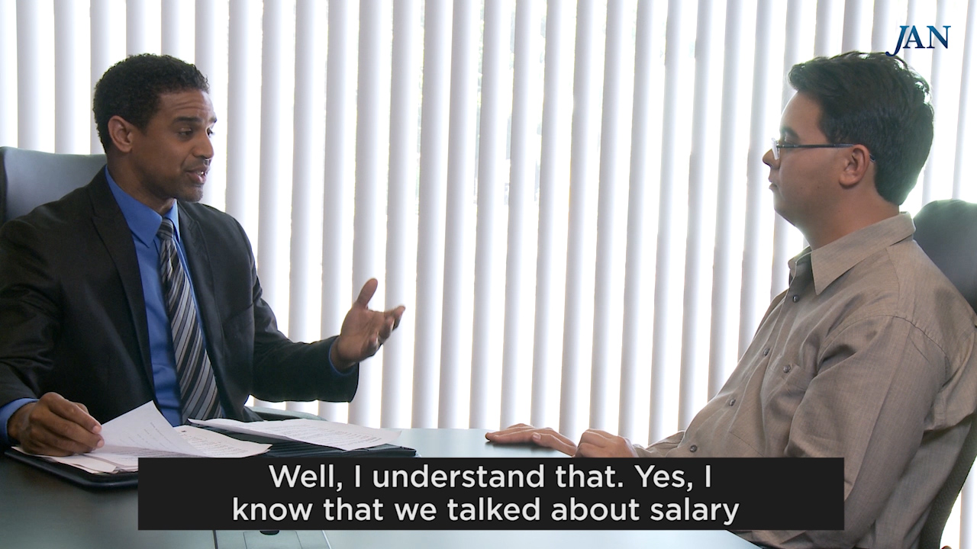
JAN Video: Interview Challenges
Notes:
Show Video.

Slide 7

Hiring Best Practices
Be mindful that disability is not always apparent
Inform all applicants how to request reasonable accommodation for hiring
If an interviewee receives employment-related assistance from a service provider, engage the provider as a resource to insure the best interview
Set a relaxed tone during the interview
Communicate in a respectful manner
with all candidates

Slide 8
Hiring Best Practices
Interview applicants privately
  Limits distractions and preserves confidentiality
Adjust vocabulary to use concrete terms
when discussing job-related information
  Avoid acronyms, idioms, flowery or technical terms
Adjust conversational speech rate according to
the interview situation
  Observe when interviewee appears confused, distressed, or not responsive to questions
Modify interview questions according to responses

Slide 9
Hiring Best Practices
Ask only job-related questions that speak to the functions of the job for which the applicant is applying
Concentrate on technical and professional knowledge, work experience, skills, credentials, education, etc.
Discuss work-related barriers and possible accommodations only if disability is known and there is good reason to believe that limitations will affect performance of job duties
  Avoid probing questions about disability

Slide 10

Hiring Best Practices
Consider a second chance interview
  Be flexible and consider a more effective method for asking questions or interview in a different location
Demonstrate the organization’s commitment to maintaining an environment where all employees can contribute and succeed

Slide 11

Hiring Best Practices
Keep disability and
accommodation-related
information confidential
Let applicants/candidates know who to contact if there is a need for a modification at work due to a personal reason, so the issue can be addressed privately
Made a business decision for personal reasons and do not discuss applicants’/candidates’ personal information with others

Slide 12







Contact JAN
(800) 526-7234 (V) - (877) 781-9403 (TTY)
AskJAN.org
jan@askjan.org
(304) 216-8189 via Text
janconsultants via Skype

