Slide 1
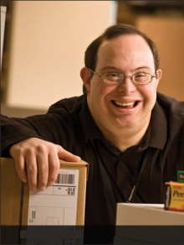
Retaining Employees with Chronic Health Conditions
October 1, 2017

Slide 2
Accommodation Primer
The basis for inclusive employment is the reasonable accommodation (RA) policy and process
The foundation for reasonable accommodation is a robust interactive process (IP)
The trigger for RA and IP is a request for an accommodation or recognition of an obvious barrier to someone with a known disability
A request for accommodation includes two essential elements — a medical condition and a related challenge at work

Slide 3
What is the Interactive Process?
A collaborative effort to identify effective accommodation solutions
Creates a standard of practice
Facilitates communication and inclusion
Demonstrates good faith
Leads to ADA compliance

Slide 4
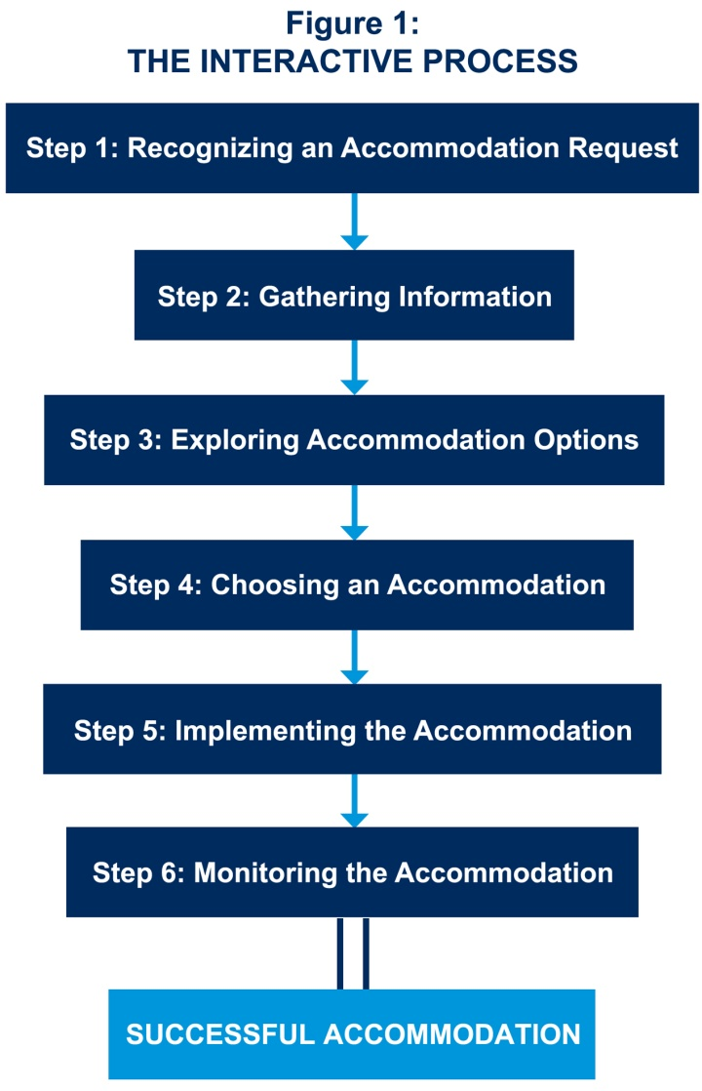
JAN’s Interactive Process
For tips about the process, go to: http://AskJAN.org/media/eaps/interactiveprocessEAP.doc

Slide 5
Questions to Consider
About the medical impairment:
What is the nature of the impairment?
What are the limitations/restrictions?
How long will the impairment last?
What is the duration of restrictions?
Can medical documentation be obtained?
Yes, when the disability and need for accommodation are not known or obvious
Notes:
For more on the ADAAA definition of disability, go to : http://AskJAN.org/corner/vol05iss04.htm

Slide 6
Questions to Consider
About job functions & performance:
What job functions, policies, or procedures are affected by the limitations?
Is performance or conduct affected?
Are there any safety issues?
Can job functions be performed in a different way?

Slide 7
Questions to Consider
About job accommodations:
What type of accommodation is needed?
Job Restructuring, Modified Schedules, Modified Policies, Assistive Technology, Telework, Leave, Reassignment, Service Animal, etc.
Is the accommodation reasonable – meaning feasible or plausible?
Will the accommodation be effective?
Is the employee still qualified?

Slide 8
Practices to Avoid
Failing to recognize a request for reasonable accommodation (RA) and not engaging in the interactive process (IP)
Being curt, non-empathetic, failing to listen with intent
Ignoring timeframes for responding/implementing accommodation
Neglecting to adequately document IP
Failing to work collaboratively with employee
Making excuses for why accommodation can’t be provided
Neglecting to communicate accommodations to essential personnel
Failing to monitor accommodations

Slide 9
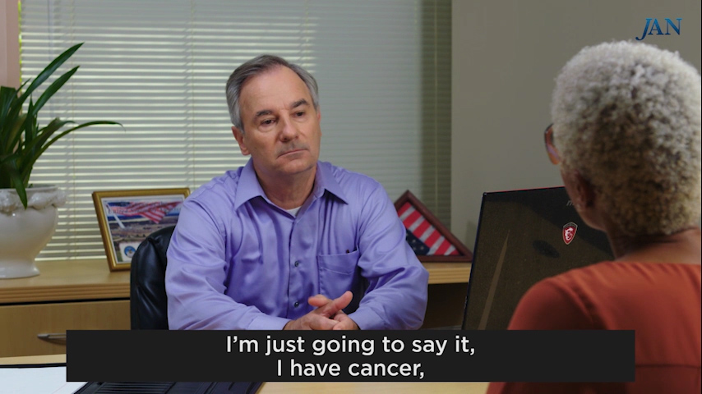
Toolkit Training Videos

Slide 10
Retention Best Practices
Create a culture of inclusion in the workplace where all employees have the ability to contribute and be successful
Empower the employee to be confident in proposing potential accommodations that may work for them and the workplace
Train managers on company accommodation policy and practices
Train managers to recognize accommodation requests to understand their role and to know what to do next, i.e., reach out to Accommodation Specialist
Discourage leave as a first option when disability occurs

Slide 11
Retention Best Practices
Ensure Human Relations, Employee Relations, Medical Management, or Diversity & Inclusion know their role in supporting both the manager as well as employee
Train managers to communicate quickly and in writing with the employee showing a good faith interactive conversation
Train managers to be empathetic and express a willingness to listen to ensure a robust conversation
Leverage company culture (e.g. mentoring) and business trends (e.g. massive retirement and need for cross-training)

Slide 12
Retention Best Practices
Keep disability- and accommodation-related information confidential
Let applicants/candidates know who to contact if there is a need for a modification at work due to a personal reason, so the issue can be addressed privately
Made a business decision for personal reasons and do not discuss applicants’/candidates’ personal information with others

Slide 13
Accommodation Resources
Accommodation Ideas for Individuals with Cancer
https://AskJAN.org/media/canc.htm
Accommodation Ideas for Individuals with Vision Loss
https://AskJAN.org/media/visi.htm
For other disabilities and medical conditions, go to https://AskJAN.org/links/atoz.htm

Slide 14
Contact JAN
(800) 526-7234 (V) - (877) 781-9403 (TTY)
AskJAN.org
jan@AskJAN.org
(304) 216-8189 via Text
janconsultants via Skype

