Slide 1
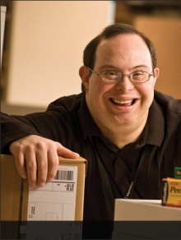
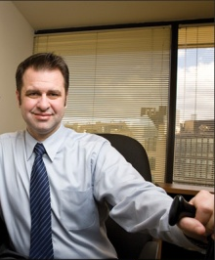
Retaining an Employee with an Intellectual Disability After a Supervisor Change
August 6, 2018

Slide 2
Accommodation Primer
The basis for inclusive employment is the reasonable accommodation (RA) policy and process
The foundation for reasonable accommodation is a robust interactive process (IP)
The trigger for RA and IP is a request for an accommodation or recognition of an obvious barrier to someone with a known disability
A request for accommodation includes two essential elements — a medical condition and a related challenge at work

Slide 3
What is the Interactive Process?
A collaborative effort to identify effective accommodation solutions
Creates a standard of practice
Facilitates communication and inclusion
Demonstrates good faith
Leads to ADA compliance

Slide 4
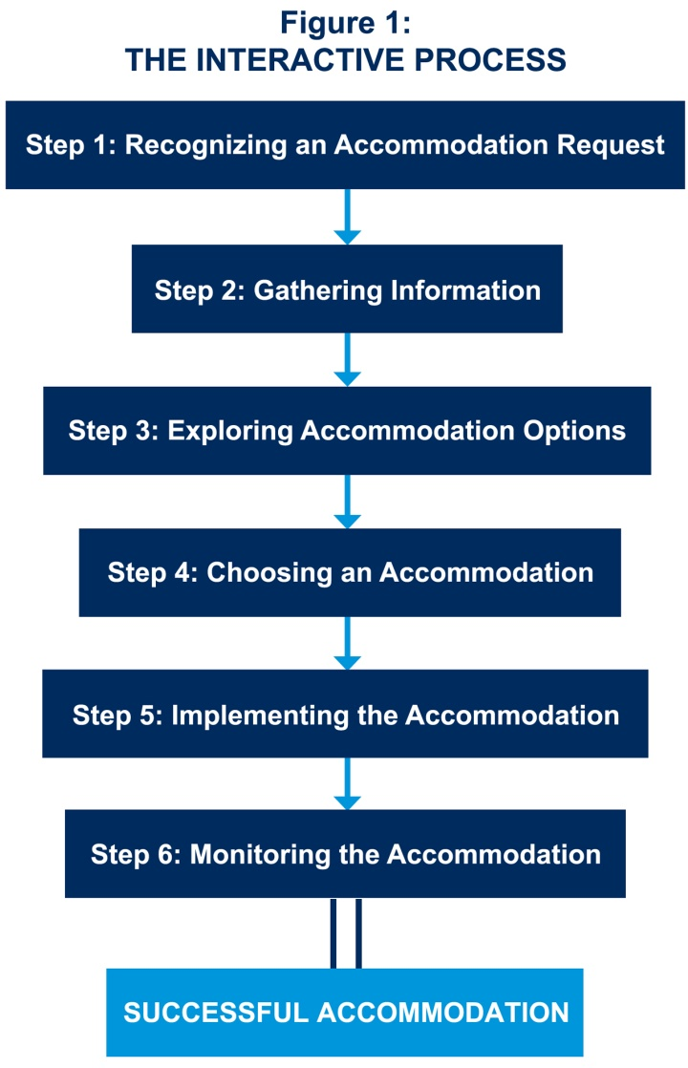
JAN’s Interactive Process
For tips about the process, go to https://AskJAN.org/topics/interactive.cfm

Slide 5
Questions to Consider
About the medical impairment:
What is the nature of the impairment?
What are the limitations/restrictions?
How long will the impairment last?
What is the duration of restrictions?
Can medical documentation be obtained?
Yes, when the disability and need for accommodation are not known or obvious
Notes:
For more on the ADAAA definition of disability, go to : http://AskJAN.org/corner/vol05iss04.htm

Slide 6
Questions to Consider
About job functions & performance:
What job functions, policies, or procedures are affected by the limitations?
Is performance or conduct affected?
Are there any safety issues?
Can job functions be performed in a different way?

Slide 7
Questions to Consider
About job accommodations:
What type of accommodation is needed?
Job Restructuring, Modified Schedules, Modified Policies, Assistive Technology, Telework, Leave, Reassignment, Service Animal, etc.
Is the accommodation reasonable — meaning feasible or plausible?
Will the accommodation be effective?
Is the employee still qualified?

Slide 8
Practices to Avoid
Failing to recognize a request for reasonable accommodation (RA) and not engaging in the interactive process (IP)
Being curt, non-empathetic, failing to listen with intent
Ignoring timeframes for responding/implementing accommodation
Neglecting to adequately document IP
Failing to work collaboratively with employee
Making excuses for why accommodation can’t be provided
Neglecting to communicate accommodations to essential personnel
Failing to monitor accommodations

Slide 9
Toolkit Training Videos

Slide 10
Employees With Intellectual Disabilities
What challenges do employees with intellectual disabilities experience on the job?
Communicating / interacting with supervisors, coworkers, and customers
Reading, comprehending, learning, and retaining new information
Sustaining attention and focus
Organizing, planning, and prioritizing
Completing tasks
Adjusting to change

Slide 11
Employees With Intellectual Disabilities
Learning and Retaining Information
Use voice-activated recorder to record verbal instructions
Provide written information and checklists
Provide pictures, symbols, or diagrams instead of words
Prompt employee with verbal cues (reminders)
Use written or pictorial instructions for frequently-used machines, procedures, tasks
Read information or provide information on audiotape
Use screen-reading software on computer

Slide 12
Employees With Intellectual Disabilities
Organization and Task Completion
Minimize clutter
Label and color-code items or resources
Divide large tasks into multiple smaller tasks
Use task list with numbers or symbols
Avoid re-organization of workspace
Provide verbal prompts (reminders)
Provide written or symbolic reminders
Use alarm watch or beeper
Use jig, job aid, or template to increase productivity
Arrange materials in order of use
Provide additional training or retraining as needed

Slide 13
Etiquette for Engaging Individuals
with Intellectual Disabilities
Speak to the person in clear sentences, using simple words and concrete—rather than abstract—concepts. Help her understand a complex idea by breaking it down into smaller parts
Don’t talk down to people who have developmental disabilities. Gauge the pace, complexity, and vocabulary of your speech according to theirs
People with developmental disabilities often rely on routine and on the familiar to manage work and daily living. Be aware that a change in the environment or in a routine may require some attention and a period of adjustment

Slide 14
Best Practices
Create a culture of inclusion in the workplace where all employees have the ability to contribute and be successful
Ensure Human Relations, Employee Relations, Medical Management, or Diversity & Inclusion know their role in supporting both the manager as well as employee
Train managers to communicate quickly and in writing with the employee showing a good faith interactive conversation
Train managers to be empathetic and express a willingness to listen to ensure a robust conversation

Slide 15
Best Practices
Purchase or develop an accommodation tracking system to support supervisors in responding to the accommodation needs of the employee
Develop a plan for continuity of effective accommodations between old and new supervisors to alleviate problems before they arise
Provide the time for the supervisor to get to know the individual’s strengths and accommodation needs
Partner with external resources for such services as job coaching
Get everyone involved together (HR, job coach, the individual, and supervisor) to brainstorm about what may work as an accommodation

Slide 16
Best Practices
Remember there are numerous job aids and tools for communicating with people with intellectual disabilities. Job aids can be used by other coworkers as well to enhance productivity
Transportation for people with disabilities who are not able to drive may impact scheduling - an accommodation may be to maintain consistency of hours when public transportation is available
Like any employee, individuals with disabilities welcome and appreciate positive reinforcement that is customized to their personality and interests
Individuals with intellectual and developmental disabilities have full lives outside of work like everyone else

Slide 17
Best Practices
Keep disability- and accommodation-related information confidential
Let employees know who to contact if there is a need for a modification at work due to a personal reason, so the issue can be addressed privately
Made a business decision for personal reasons and do not discuss employees personal information with others

Slide 18
Accommodation Resources
Accommodation and Compliance Series: Employees with Intellectual Impairment or Cognitive Impairment https://AskJAN.org/publications/Disability-Downloads.cfm?pubid=571367
Job Coaches and Support People for Individuals with Intellectual Disabilities https://AskJAN.org/articles/Job-Coaches-and-Support-People-for-Individuals-with-Intellectual-Disabilities.cfm
Intellectual Impairment https://AskJAN.org/disabilities/Intellectual-Impairment.cfm
Questions & Answers about Persons with Intellectual Disabilities in the Workplace and the Americans with Disabilities Act (ADA) https://www.eeoc.gov/laws/types/intellectual_disabilities.cfm
What’s in a Routine? https://AskJAN.org/blogs/jan/2016/08/what-s-in-a-routine.cfm

Slide 19
Contact JAN
(800) 526-7234 (V) - (877) 781-9403 (TTY)
AskJAN.org
jan@AskJAN.org
(304) 216-8189 via Text
janconsultants via Skype

