Slide 1
Retaining Employees with Disabilities Disability Inclusion & Best Practices for the Employee Lifecycle

Slide 2
Request or Disclosure?
What is an accommodation request?
When an applicant or employee requests an adjustment or change at work for a reason related to a medical impairment
What is not an accommodation request?
Voluntary self-identification
Disclosure absent work-related barrier or request
Request for workplace adjustments available to employees without disabilities

Slide 3
Questions to Consider
About the medical impairment:
What is the nature of the impairment?
What are the limitations/restrictions?
How long will the impairment last?
What is the duration of restrictions?
Can medical documentation be obtained?
Yes, when the disability and need for accommodation are not known or obvious
Notes:
For more on the ADAAA definition of disability, go to : http://askjan.org/corner/vol05iss04.htm

Slide 4
Questions to Consider
About job functions & performance:
What job functions, policies, or procedures are affected by the limitations?
Is performance or conduct affected?
Are there any safety issues?
Can job functions be performed in a different way?

Slide 5
What is the Interactive Process?
A collaborative effort to identify effective accommodation solutions
Creates a standard of practice
Facilitates communication and inclusion
Demonstrates good faith
Leads to ADA compliance

Slide 6
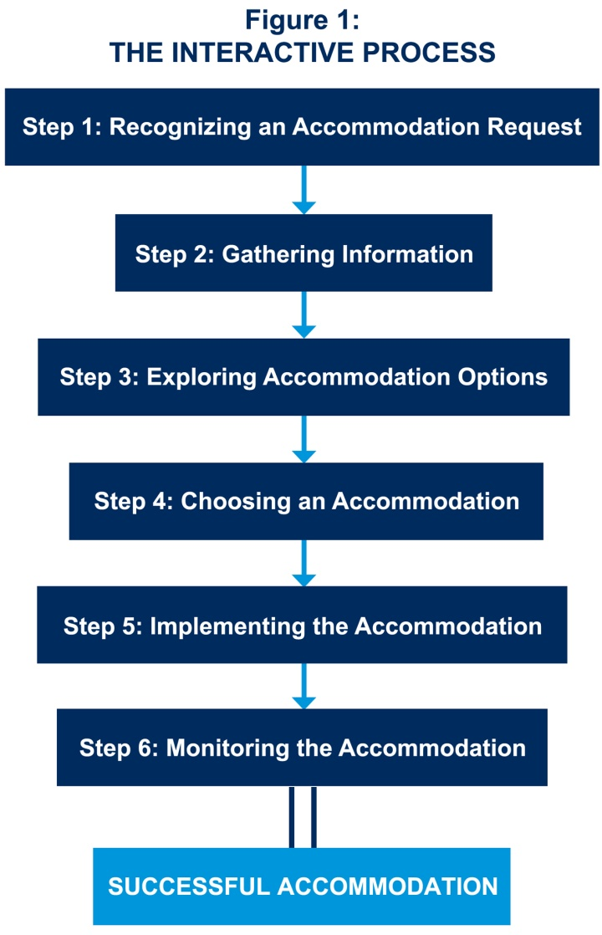
JAN’s Interactive Process
For tips about the process, go to: http://AskJAN.org/media/eaps/interactiveprocessEAP.doc

Slide 7
Questions to Consider
About job accommodations:
What type of accommodation is needed?
Job Restructuring, Modified Schedules, Modified Policies, Assistive Technology, Telework, Leave, Reassignment, Service Animal, etc.
Is the accommodation reasonable – meaning feasible or plausible?
Will the accommodation be effective?
Is the employee still qualified?

Slide 8
Practices to Avoid
Failing to recognize a request for reasonable accommodation (RA) and not engaging in the interactive process (IP)
Being curt, non-empathetic, failing to listen with intent
Ignoring timeframes for responding/implementing accommodation
Neglecting to adequately document IP
Failing to work collaboratively with employee
Making excuses for why accommodation can’t be provided
Neglecting to communicate accommodations to essential personnel
Failing to monitor accommodations

Slide 9
Video: Interactive Process
Notes:
Show video.

Slide 10
Interactive Process Best Practices
Educate workforce about RA policy and encourage all employees to discuss, with management/HR, modifications/tools needed to be successful
Train hiring managers and supervisors to recognize when an accommodation request is received, respond without delay, and document actions

Slide 11
Interactive Process Best Practices
Privately engage the employee to discuss accommodation requests
Listen, express empathy, and exhibit understanding of concerns shared by employee
Build trust through positive, constructive dialogue and by demonstrating interest in identifying solutions

Slide 12
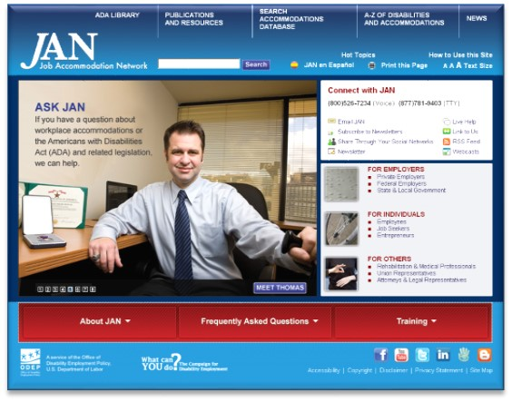
Interactive Process Best Practices
Use information about work-related limitations and barriers to explore accommodation solutions collaboratively with employee
Break-down silos and engage internal and external resources to support the accommodation process

Slide 13
Interactive Process Best Practices
Document the interactive process – beginning to end, to benefit both parties
Be responsive – DO SOMETHING!
Inform essential personnel about accommodations, but preserve confidentiality of medical information

Slide 14
Interactive Process Best Practices
Monitor accommodations for effectiveness and make changes when necessary
Commit to creating an environment where all employees have the ability to contribute and be successful

Slide 15
Retention Best Practices
Keep disability and accommodation-related information confidential
Let employees know who to contact if there is a need for a modification at work due to a personal reason, so the issue can be addressed privately
Made a business decision for personal reasons and do not discuss employees' personal information with others

Slide 16
Contact JAN
(800) 526-7234 (V) - (877) 781-9403 (TTY)
AskJAN.org
jan@askjan.org
(304) 216-8189 via Text
janconsultants via Skype

