Slide 1
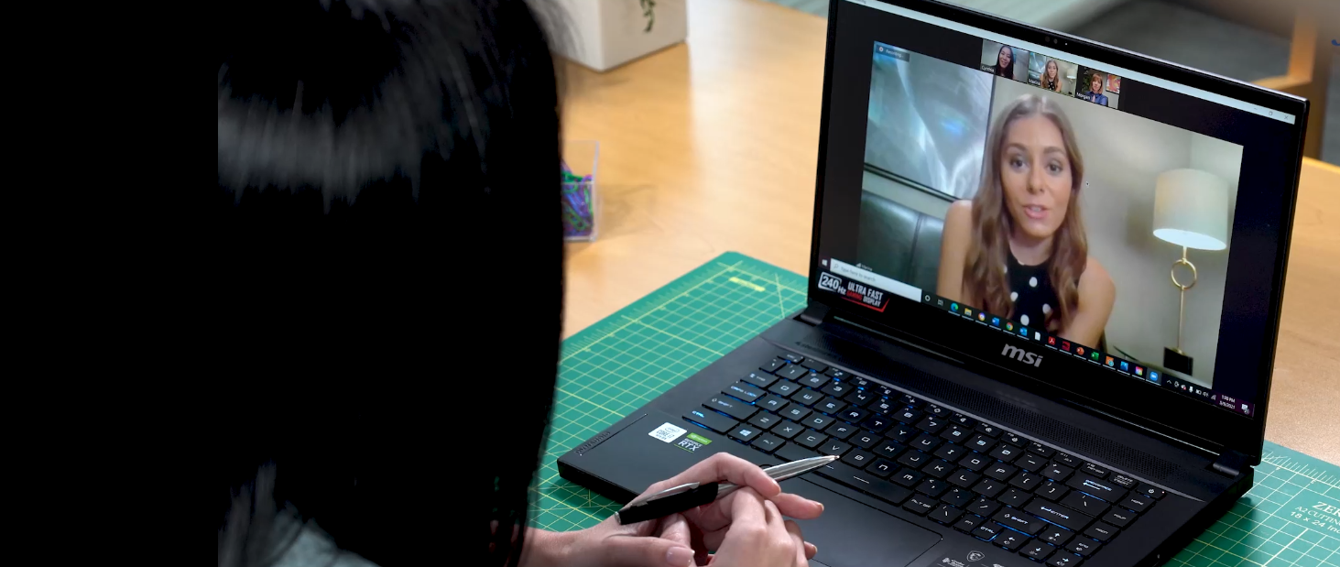
Role Play Training Series: Telework As An Accommodation
Telework as a Reasonable Accommodation Under the Americans with Disabilities Act (ADA)
Notes:
JAN’s Telework as an Accommodation is a Role Play Training Series video that demonstrates that telework should be considered as a form of reasonable accommodation when requested by an employee with a disability and that personal medical information may be requested to support this type of ADA accommodation.
This video demonstrates that when an employee with a disability realizes benefits from teleworking that enable them to be productive, they may request this as an accommodation, even when a workplace policy or practice usually limits telework for employees without disabilities. Due to associated benefits to health, safety, and/or productivity from their experience teleworking, employees with various disabilities are now more willing to disclose a disability and to request to work at home as a reasonable accommodation.
The video shows that, when an exception to a telework policy/practice is requested due to a disability-related reason as a reasonable accommodation under the Americans with Disabilities Act (ADA), an employer may ask for personal health information to provide a flexible work arrangement that may not be available to others.
Points made:
• Employees with disabilities who never requested accommodations prior to teleworking may realize benefits from working at home that enhance productivity.
• A policy/practice exception may need to be considered as a reasonable accommodation under the ADA.
• This request necessitates a collaborative interactive process.
• Telework is a form of accommodation under the ADA.
• Medical/personal health information may be requested to support an ADA reasonable accommodation request, when appropriate.
• There are ADA confidentiality rules that restrict sharing disability-related information with coworkers.

Slide 2
Role Play Scenario
Marina works for a call center at a financial services company. Everyone at her company has been working remotely fulltime for over a year, but now they are returning to the office.
Marina’s supervisor, Cynthia, wants everyone to return to the worksite to enhance teamwork and customer satisfaction.
Cynthia is enthusiastic about all employees returning to the worksite, but Marina is concerned about distractions in the office.
Notes:
Marina works for a call center at a financial services company.
Everyone at her company has been working remotely fulltime for over a year, but now they are being asked to return to working in the office.
Marina’s supervisor, Cynthia, wants everyone to return to the worksite to enhance teamwork and customer satisfaction.

Slide 3
Role Play Scenario Continued
While meeting with Cynthia, Marina shares that she can do her job more effectively while teleworking because she can use strategies to help with concentration.
Marina realized while teleworking that she was less anxious, better able to concentrate, and more productive due to fewer distractions at home.
Notes:
While meeting with Cynthia, Marina shares that she can do her job more effectively while teleworking because she can use strategies to help with concentration. She has more control over the environment around her than in an office setting and can minimize distractions so that her focus strategies are more effective.
Some employees with disabilities realize the positive effects of teleworking after having an opportunity to work remotely. Marina noticed while teleworking that she was less anxious and better able to concentrate – resulting in higher customer experience/satisfaction ratings and enhanced self-confidence while lowering the stress associated with performing the job.

Slide 4
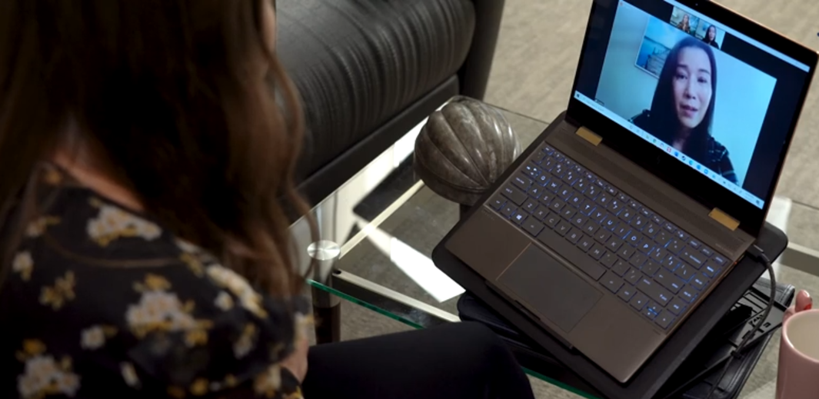
Role Play Scenario Continued (2)
Cynthia asks Marina to try working according to the telework policy; one day a week.
Marina found one day was not enough. She struggled with distractions while working on-site.
Marina requests to telework fulltime, due to trouble with learning and attention.
Cynthia realizes that Marina is asking for an exception to the telework policy.
Marina meets remotely with Cynthia to ask about teleworking fulltime.
Notes:
Cynthia asks Marina to try working according to the telework policy that applies to all employees; one day a week.
However, Marina found one day a week working at home was not enough, as she continued to struggle with the noises and distractions when working in the office. Marina requests to telework fulltime, due to trouble with learning and attention.
Cynthia realizes that Marina is sharing personal health information and is asking for an exception to the telework policy. After reaching-out to Morgan in human resources for assistance, Cynthia understands that Marina is requesting an accommodation under the Americans with Disabilities Act (ADA).

Slide 5
Recognizing AN Accommodation Request
When an employee requests a work-related change for a reason related to a medical/health condition, this is a request for accommodation under the Americans with Disabilities Act (ADA)
An accommodation request is not required to be formally stated, documented, or to include specific words
Employer may ask the employee to clarify what is being requested and why
JAN Resource:
Recognizing an Accommodation Request Under the ADA
Notes:
The requirement to engage in the interactive process or conversation under title I of ADA is triggered when a request for reasonable accommodation is received, or when an employer has a reasonable belief that an employee may need accommodation due to a known disability that is affecting job performance or the ability to access benefits and privileges of employment (e.g., training opportunities, career development, etc.).
Recognizing an accommodation request is an important first step in the interactive accommodation process. Generally, the responsibility to request accommodation falls on the individual with the disability; employers are not expected to assume that someone has a disability or to guess what accommodations are needed. Approximately 70% of disabilities are non-apparent and may present a challenge situationally.
When an individual makes it known that an adjustment or change is needed at work, due to a medical reason, consider whether the employee is making a request for accommodation under the ADA.
Accommodation requests are not required to be formal or documented. Meaning, an individual with a disability has no obligation to submit a formal request in writing. No federal government-issued or required ADA forms exist. Also, when making a request for accommodation, there is no requirement for the individual to assert their rights, to mention the ADA, or to include specific terms like "reasonable accommodation" or “disability.”
Because the ADA doesn’t require that reasonable accommodation be requested in a formal way, or at a particular time, it can sometimes be difficult for employers to recognize a request and to know when to engage in the interactive process or conversation. When an employer is not sure whether an employee has requested an accommodation, they may ask the employee to clarify what is being requested and why. This puts the onus on the individual to explain why they’ve mentioned a health condition or disability or asked for an adjustment at work.
For more information, see the Job Accommodation Network (JAN) resource, Recognizing an Accommodation Request Under the ADA at https://AskJAN.org/articles/Recognizing-an-Accommodation-Request-Under-the-ADA.cfm.

Slide 6
Create a safe space
Creating a safe space for self-identification and disability disclosure is essential to the success of the interactive accommodation process
Active empathetic listening to responses from open-ended questions often yields information to support this process
Notes:
It is important for managers and human resources professionals to be aware of how challenging it can feel for anyone to ask for an accommodation, and therefore do their best to create a welcoming and safe environment for a person with a disability to make their accommodation needs known without fear of negative repercussions. Creating a safe space for self-identification and disability disclosure is essential to the success of the interactive accommodation process. This process is where the employer and the individual with a disability work together to explore accommodation solutions.
If you are wondering if an employee may be struggling with whether to ask for a workplace adjustment you might try asking open-ended questions such as:
“Is there anything I can do support you to be successful in your role?”
“What do you think might make it easier for you to do your best work?”
“Is there a challenge or barrier you are encountering you could help me understand?”
Active empathetic listening to responses from open-ended questions about job performance and an employee’s need for some form of support often yields the best outcomes. This combined with open/encouraging body language, facial expression and a warm tone will help the employee to feel more comfortable sharing their concerns, discussing their disability, and exploring possible accommodations.

Slide 7
Disability disclosure and the accommodation conversation
Employees sometimes share personal information about their health when asking for an adjustment at work but may not realize this is known as disability disclosure or recognized as a request for accommodation
The individual may not identify as a person with a disability
Stigma is often a barrier to self-identification, disability disclosure, and requesting an accommodation
Health-related disclosures often precede a conversation about job accommodations
JAN Resource:
Disability Disclosure Topics
Notes:
Employees sometimes share personal information about their health when asking for an adjustment at work but may not realize this is known as disability disclosure, or that this disclosure may be recognized as a request for accommodation under the ADA. They may not identify as a person with a disability.
Sometimes the employer isn’t sure whether an employee has requested an accommodation. They may need to directly ask the employee to clarify why they have shared this health-related information. This puts the onus on the individual to explain, and the manager or HR to inquire, why they’ve mentioned a disability or health challenge, or asked for a change at work.
Of course, situations may also arise when an employer has reason to believe that an accommodation is needed because of a known and/or apparent condition, but the employee hasn’t formally disclosed a disability or requested a work-related adjustment.
Unfortunately, due to the prevalent stigma associated with identifying as a person with a disability, it is not unusual for the need for an accommodation to become apparent as the result of an employee experiencing challenges in their job because they did not feel comfortable proactively asking for what they needed early on. Stigma can be an even bigger barrier to asking for an accommodation for someone who is a member of more than one under-represented and/or marginalized identity group such as a person of color or a member of the LGBTQ+ community who has a disability. Culturally many communities of color view disability, particularly mental health conditions, as a very private matter that is rarely discussed even within the family.
When personal health related information is disclosed in connection with a work-related barrier, this disclosure often precedes a conversation about job accommodations and questions about the medical/health condition and associated limitations involved.
JAN offers resources about disability disclosure topics at AskJAN.org, A to Z by Topic: Disclosure at https://AskJAN.org/topics/Disability-Disclosure.cfm.

Slide 8
Facilitate the accommodation conversation
For example:
“Is there anything I can do to help?”
“Please tell me more. Why are you having trouble at work?”
“What do you think may make it easier for you to do your best work?”
“The information you share will be kept confidential.”
Notes:
Asking, “How can I help?” is a way of creating a safe space for disability-disclosure. This strategy cultivates a welcoming and supportive work environment and can facilitate the accommodation conversation by opening the door to discuss job-related barriers and collaboratively explore reasonable accommodation solutions to improve performance. Try asking open-ended questions such as:
“Is there anything I can do to help?”
“Please tell me more. Why are you having trouble at work?”
“What do you think may make it easier for you to do your best work?”
“The information you share will be kept confidential.”
Mirroring the choice of words the employee uses to describe the challenges they are experiencing at work will help to keep the discussion conversational and constructive.

Slide 9
Flexible Work Arrangement Policies and Practices
Flexible work arrangement policies and/or practices may support providing adjustments without engaging in the full accommodation process
When telework is allowed as a matter of policy or practice, employees with disabilities should not be required to take extra steps to access a benefit of employment that is available to others
Follow the ADA when flexible work arrangements are not a policy or practice, or an employee with an ADA disability asks for an exception
JAN Resources:
Workplace Flexibility, the ADA, and Requesting Medical Information
A Practical Approach to Telework as a Reasonable Accommodation During the Pandemic
Notes:
It’s important to note that a request from an employee with a disability for a flexible work arrangement or access to benefits and privileges already available to employees without disabilities is not necessarily a request for reasonable accommodation and may not require a request for documentation from a health care professional or engaging in the interactive process.
When an employee asks to telework for a reason related to a health condition or disability, be sure to check whether the employer’s usual telework policy/practice covers the request. It could violate the ADA to make employees with disabilities take extra steps to access a benefit of employment that is available to all employees. For more information, see Workplace Flexibility, the ADA, and Requesting Medical Information at https://AskJAN.org/articles/Workplace-Flexibility-the-ADA-and-Requesting-Medical-Information.cfm.
When it is not a practice or policy to work from home, or an employee with an ADA disability asks for an exception to an existing telework policy or practice (e.g., access to telework beyond the current policy), this may require that the employer and employee engage in the accommodation conversation – the interactive process – to work through the specifics of the request.
JAN offers resources to help employers process telework requests. One resource is A Practical Approach to Telework as a Reasonable Accommodation During the Pandemic at https://AskJAN.org/articles/A-Practical-Approach-to-Telework-as-a-Reasonable-Accommodation-During-the-Pandemic.cfm.

Slide 10
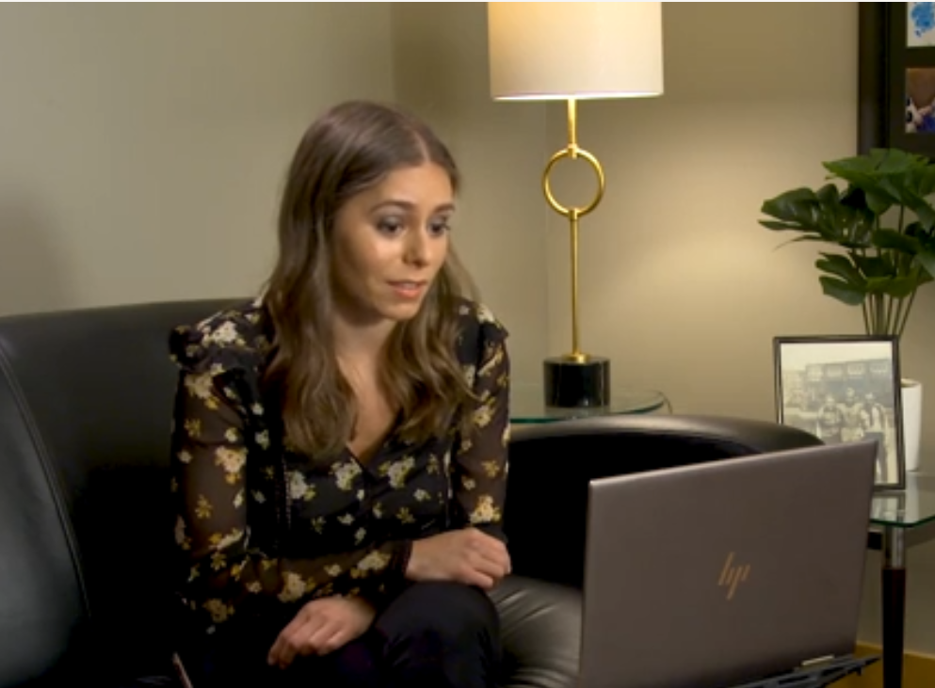
Telework Benefits
People with a broad range of medical conditions have learned they can be more productive and feel healthier and less stressed working from home
Benefits may include:
Improved focus due to fewer distractions
Ability to control the work environment such as allergens, lighting, and ergonomics
Flexibility to take breaks
Avoiding the stressors and transportation challenges of a commute
Notes:
As a result of pandemic shutdowns and mandatory telework, people with a broad range of medical/health conditions learned they can be more productive and feel more focused and less stressed working at home. For example, the pandemic provided an opportunity for individuals with various forms of neurodiversity such as Autism Spectrum, learning, attention, anxiety and other conditions that can impact the ability to focus while at the worksite to experience working in a quieter more controlled work environment.
Many employees noticed that they were more readily able to focus due to fewer distractions, as well as the ability to control other aspects of the work environment such as allergens, lighting, ergonomics, taking breaks as needed, and avoiding the stressors and transportation challenges of a commute.
The pandemic driven necessity for most office-based employees to work from home demonstrated that remote work is not only possible for many more types of roles than previously approved, but also that there is a strong business case to allow telework, due to reduced employer expenses associated with maintaining an office presence, as well as productivity gains and retention of valued employees.

Slide 11
Telework and performing essential job duties
Changing the location where work is performed may be a form of modifying a workplace policy as a reasonable accommodation, even when an employer does not generally allow employees to telework (EEOC)
Work At Home/Telework as a Reasonable Accommodation-Fact Sheet
Review whether essential job functions can be performed remotely to determine if telework is a reasonable accommodation
JAN Resources:
Telework
Telework Accommodation Request Flowchart
Notes:
While there are often differing views between managers and employees about the pros and cons of employees working remotely, telework is becoming much more prevalent both for individuals with and without disabilities. Also, many employers have experienced a significant uptick in employees with various disabilities being more willing to disclose a disability and request telework as a reasonable accommodation due to realizing the positive effects of working at home.
Telework has always been a form of accommodation under the ADA. This type of flexible work arrangement, can expand employment opportunities for many workers, but particularly for employees with disability-related limitations that affect commuting to work or performing job duties at a traditional worksite.
The Equal Employment Opportunity Commission (EEOC) says that telework/work at home may be a form of reasonable accommodation under the ADA, because changing the location where work is performed may be a form of modifying a workplace policy. Telework may be a reasonable accommodation, even when an employer does not generally allow employees without disabilities to telework. For information about telework and the ADA, see the EEOC Work At Home/Telework as a Reasonable Accommodation-Fact Sheet at https://www.EEOC.gov/laws/guidance/work-hometelework-reasonable-accommodation.
Telework is often suggested as an accommodation solution to address a variety of impairments, limitations, and work-related barriers. When exploring telework, it is necessary to identify and review the essential job functions. The essential functions are tasks that are fundamental to performing a specific job. Employers are not required to remove essential job duties to permit employees to work at home as an ADA accommodation. For some jobs, the essential duties can only be performed in the workplace, but for many jobs, some or all of the essential duties can be performed remotely. Evaluate each situation case-by-case to determine whether it is reasonable to perform essential duties at home.
For more information about telework as an ADA accommodation, see JAN’s Accommodation and Compliance: Telework at https://AskJAN.org/topics/telework.cfm.
JAN also offers a resource to help employers determine whether a request to telework is a request for accommodation under the ADA. See Telework Accommodation Request Flowchart at https://AskJAN.org/articles/Telework-Accommodation-Request-Tool.cfm.

Slide 12
Personal and private Medical Information
The accommodation conversation often includes questions about health and wellness — known as disability-related inquiries under the ADA
Some people are reluctant to openly discuss medical information — details about their disability and limitations that may be relevant to the accommodation conversation
The ADA requires medical information to be kept private and confidential
Notes:
The accommodation conversation often includes questions about health and wellness – known as disability-related inquiries under the ADA. The information obtained in response to these questions is considered medical information.
Some people are not comfortable sharing personal medical information with their employer and are reluctant to openly discuss details about their disability and functional limitations that may be relevant to the accommodation conversation.
This information is sometimes needed to determine whether the employee requesting accommodation has an ADA covered disability. Assuring the employee that the ADA requires all medical information to be kept private and confidential, and explaining who will have access to this information on a need-to-know basis only, may help the employee feel more comfortable about sharing personal medical/health information.

Slide 13
Medical Information and the Interactive accommodation Process
Medical information may be requested when an employee’s disability and/or need for accommodation are not obvious or already documented
This information helps establish the existence of an ADA covered disability and the related need for accommodation
JAN Resource:
How to Determine Whether a Person Has an ADA Disability
Notes:
The employee is often the best source of information about their disability and possible accommodations. If the employee cannot provide the necessary information, then medical information from a health care or other appropriate professional can be useful.
Under the ADA, medical information may be requested from an employee when it is job-related and consistent with business necessity. This is when an employee’s disability and/or need for accommodation are not obvious or already documented.
Medical information can help establish the existence of an ADA covered disability and the related need for accommodation. To receive an accommodation under the ADA, an employee must have an actual or record of an ADA disability. The ADA definition of disability is an impairment that substantially limits a major life activity.
Medical information may be requested to establish that the employee has an impairment that affects a major life activity and substantially limits performing the major life activity. The important thing for employers to remember is not to ask for too much information.
JAN offers a resource that may help in asking questions to determine who has an ADA disability. See How to Determine Whether a Person Has an ADA Disability at
https://AskJAN.org/publications/consultants-corner/vol05iss04.cfm.

Slide 14
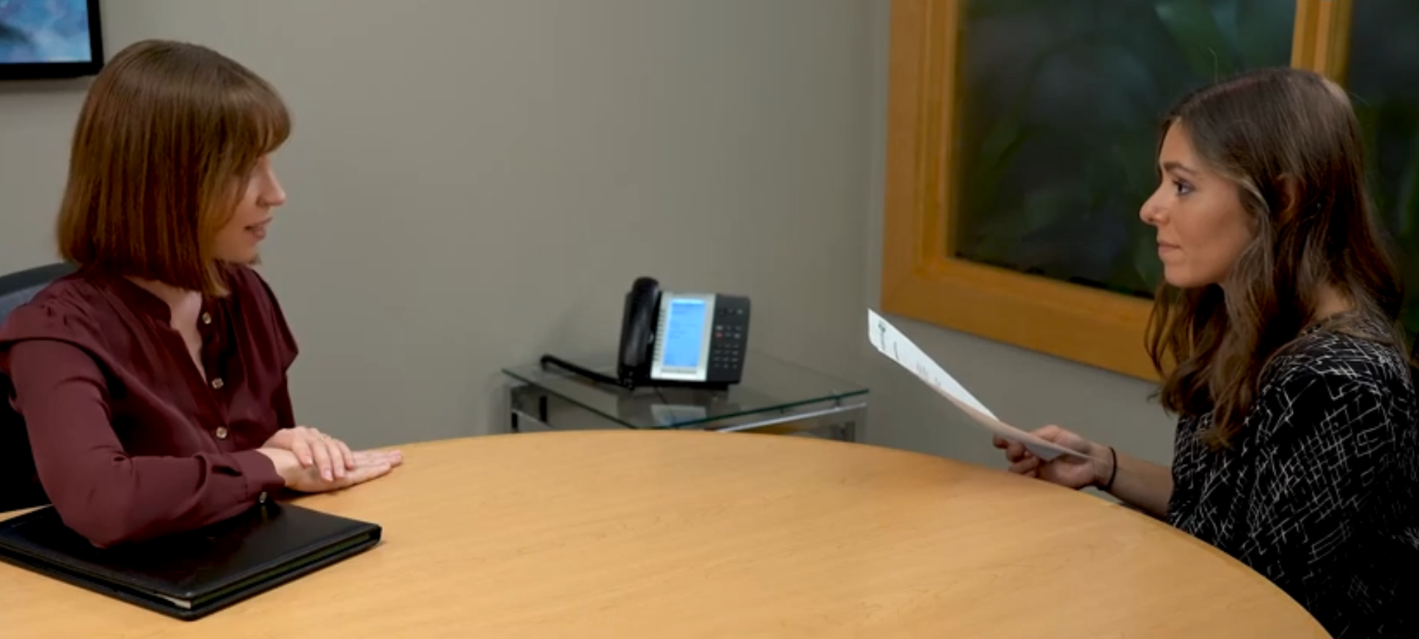
Using Forms to request Medical information
The ADA does not require the use of standardized forms when gathering medical information
Employers are encouraged to customize each medical inquiry to obtain only the information that is necessary for each individual accommodation situation
It is useful to draft a customized letter that includes necessary and job-related questions
JAN Resources:
Sample Forms
Sample Medical Inquiry Form in Response to an Accommodation Request
Notes:
The ADA does not require employers to use standardized forms when gathering medical information from employees. Employers sometimes find it helpful to develop forms for consistency and efficiency. The problem with using standardized forms under the ADA is that in some cases the improper use of those forms can lead to ADA violations. When a standard form is used to gather disability-related information in response to a request for accommodation, sometimes the employer may be asking for more information than is necessary or appropriate.
JAN encourages employers to customize each medical inquiry to obtain the information that is necessary for each individual accommodation situation. For example, some sections of the medical inquiry form might be highlighted for completion by the health care provider, while others may be modified to address a unique situation or removed entirely. It can also be useful to simply draft a customized letter that includes only the questions that are necessary to move forward in the interactive process to identify an effective reasonable accommodation.
JAN offers many sample forms that can be customized by the employer with company branding and other alterations deemed necessary. Employers may use these sample forms as a template for documenting the interactive process including:
Initial request for accommodation
Requesting disability-related information
Approval of an accommodation
Documenting details associated with the accommodation(s) provided
The appeal process and next steps in the event there is a denial of an accommodation
See JAN’s Sample Forms at https://AskJAN.org/topics/Sample-Forms.cfm and Sample Medical Inquiry Form in Response to an Accommodation Request at https://AskJAN.org/Forms/upload/medical.doc.

Slide 15
Who can provide Medical Information
Medical information can be provided by an appropriate health care or rehabilitation professional
Doctor, Physician Assistant, Nurse Practitioner
Psychiatrist, Psychologist, Licensed Mental Health Professional, Social Worker
Physical Therapist, Occupational Therapist, Speech Therapist
Vocational Rehabilitation Specialist
The appropriate professional will depend on the disability and the type of functional limitation(s)
EEOC Resource
Reasonable Accommodation and Undue Hardship Under the ADA (Q. 6)
Notes:
In requesting medical information, the employer should specify what information is needed regarding the disability, job pertinent functional limitations, and the need for reasonable accommodation.
The individual can be asked to complete a medical inquiry form or sign a limited release allowing the employer to submit a list of specific questions to a health care or other appropriate professional.
According to the Equal Employment Opportunity Commission (EEOC), an appropriate professional can be a medical doctor but may also be a psychiatrist, psychologist, nurse, physical therapist, occupational therapist, speech therapist, vocational rehabilitation specialist, or licensed mental health professional. This is not an exhaustive list of appropriate professionals under the ADA, The appropriate professional will depend on the disability and the type of functional limitation(s) it imposes or challenges the person is experiencing.
For more information, see the EEOC Enforcement Guidance: Reasonable Accommodation and Undue Hardship Under the ADA, question 6, at https://www.EEOC.gov/laws/guidance/enforcement-guidance-reasonable-accommodation-and-undue-hardship-under-ada.

Slide 16
Sufficient medical information
Documentation may not always include a diagnosis but should include details about the type of medical condition and how the condition limits the individual
Documentation may include suggested accommodations or work adjustments
The individual with the disability is often the best resource for determining what accommodation will be effective
JAN Resources:
Practical Guidance for Medical Professionals: Providing Sufficient Medical Documentation in Support of a Patient's Accommodation Request
Medical Exams and Inquiries
Notes:
Medical information may not always include a diagnosis or specific details about the medical condition but should be sufficient to establish an ADA covered disability and the need for reasonable accommodation. It might state only a few details, (e.g., confirming the person has a mental health condition, is adjusting to medication, has a chronic illness, or a learning disability). Documentation may include details such as the individual has difficulty concentrating, sitting for long periods of time, or accessing information from a computer, etc. These are simply examples.
When a health care professional is given sufficient details regarding the essential duties of an employee’s position, they may be able to suggest accommodations or work adjustments, but it’s not the health care provider’s responsibility to do this. Accommodation solutions are unique to each individual and their respective job role. Sometimes an employee will share accommodation ideas with their health care professional that they believe will be most helpful. The individual with the disability is often the best resource for determining what accommodation will be effective. The individual’s idea of what will be effective may inform the health care professional’s accommodation suggestions, if the provider concurs.
There is a saying in the disability community – if you have met one person with a certain type of disability, you have met that one person – and an employer should not assume that what worked for one employee will necessarily work well for another with a similar condition. Each person is unique and will benefit from an individualized approach to the accommodation process.
The JAN resource, Practical Guidance for Medical Professionals: Providing Sufficient Medical Documentation in Support of a Patient's Accommodation Request at https://AskJAN.org/articles/EAPS/upload/medprofessionsEAP.doc is a useful guide for health care professionals. Additional resources related to medical information and the ADA, can be found at AskJAN.org at the bottom of the A to Z by Topic: Medical Exams and Inquiries page at
https://AskJAN.org/topics/medexinq.cfm.

Slide 17
Keep Medical Information confidential
The ADA requires that medical information be kept private and confidential
Supervisors and managers may be informed about necessary restrictions on the work or duties of the employee and accommodation solutions
Coworkers may not be informed about an employee’s disability or need for accommodation
JAN Resource:
Confidentiality of Medical Information
EEOC Resource:
Reasonable Accommodation and Undue Hardship Under the ADA (Q. 42)
Notes:
The ADA requires that medical information be kept private and confidential. All medical information should be treated the same, regardless of how it was obtained (e.g., during post-offer examinations, voluntary disability disclosure, in response to a request for accommodation, etc.). It should be kept in a confidential file separate from the employee’s personnel file and in a location that is accessible only to authorized personnel. Generally, medical information and communications from an employee’s health care professional should only be shared with someone in Human Resources, or a medical or legal department.
It is important to note that if the employee with a disability also identifies as a member of another under-represented and/or marginalized group(s) - they may be particularly sensitive to information being shared about their situation as they may already be under the assumption that their actions and performance are being scrutinized to a greater degree than other members of the team.
Supervisors and managers may be informed that an employee is covered by the ADA, about necessary restrictions on the work or duties of the employee, and accommodation solutions that the employee and/or their health care professional believe would be helpful.
When a supervisor or manager is asked by other members of their team about another employee’s disability and/or accommodations they can clearly state that the employer has a policy of assisting any employee who encounters difficulties in the workplace, that many job-related issues encountered by employees are personal, and that it is the employer’s policy to respect employee privacy. It is recommended that the conversation then be refocused on what the coworker’s needs are versus their colleague with a disability and reinforced that the same courtesy/respect would be granted to them if they made a personal/confidential request.
For information on the ADA and confidentiality, see Confidentiality of Medical information at https://AskJAN.org/publications/consultants-corner/vol11iss01.cfm. See also, question 42 in the EEOC Enforcement Guidance:
Reasonable Accommodation and Undue Hardship Under the Americans with Disabilities Act at https://www.EEOC.gov/laws/guidance/enforcement-guidance-reasonable-accommodation-and-undue-hardship-under-ada.

Slide 18
Exploring accommodation solutions
The Job Accommodation Network (JAN) offers free, confidential guidance on job accommodation solutions and the ADA, and is available to anyone seeking assistance
Ask JAN – We can help
AskJAN.org
Notes:
Once the employer has gathered the necessary information to identify the employee’s limitation that is causing a problem and has identified what that problem is, accommodation solutions can be explored with the employee. Employers should always invite the employee to suggest accommodation ideas.
When it’s not known what accommodations will be helpful, especially in situations where the disability was recently diagnosed or acquired, there are resources that can help, including the Job Accommodation Network. JAN offers free, confidential guidance on the ADA and job accommodation solutions based on the requirements of the job, and the nature of the disability and related limitations. Ask JAN – We can help. Go to AskJAN.org for contact information.

Slide 19
Marina provides medical information to support telework as an accommodation. Morgan and Cynthia determine that it is reasonable to allow Marina to work at home fulltime because the essential job duties can be completed remotely. Telework will be an effective accommodation that enables Marina to concentrate and be productive.
Notes:
Marina provides medical information to support the need to work at home fulltime as an accommodation.
Morgan and Cynthia determine that it is reasonable to allow Marina to work at home fulltime because the essential job duties can be completed remotely, and she has the equipment to do so.
Marina is asked to occasionally work in the office to attend meetings, teambuilding activities, and to participate in certain types of training. The telework accommodation will be effective. It will enable Marina to be productive and will relieve the stress from trying to focus while working in the office.

Slide 20
Ask JAN – We can Help askjan.org
This training resource and accompanying video were developed and produced by the Job Accommodation Network (JAN). JAN is the leading source of free, expert, and confidential guidance on accommodations and disability employment issues.
For information about the services JAN provides, go to AskJAN.org.
JAN is funded by a contract from the U.S. Department of Labor, Office of Disability Employment Policy (ODEP) (#1605DC-17-C-0038).

