Slide 1
Building a Disability-Inclusive Organization
Ellice Switzer, EARN Workplace Disability Inclusion Associate Tracie DeFreitas, Program Leader, JAN Director of Training, Services, and Outreach

Slide 2
Guest Speaker
Ellice Switzer
Workplace Disability Inclusion Associate, Employer Assistance and Resource Network (EARN) and Extension Associate, Yang-Tan Institute on Employment and Disability, Cornell University

Slide 3
Housekeeping
3
Technical Difficulties
Q&A option at the bottom of the screen
800-526-7234 or 877-781-9403 (TTY) OR Live Chat at AskJAN.org
Frequently Asked Questions (FAQ) AskJAN.org/Training/JAN-Webcast-Frequently-Asked-Questions.cfm
Questions for Presenters
Q&A option at the bottom of the screen

Slide 4
Housekeeping 2
4
PPT Slides
Click the link included in the webcast login email you received, see the link in the chat, or go to this webcast event from the Training page at AskJAN.org
Captioning
Use the closed caption (CC) option or captioning link in the chat

Slide 5
Discussion Topics
National Disability Employment Awareness Month (NDEAM)
Inclusion@Work Framework for Building a Disability Inclusive Work Culture
Self-Identification & Disability Disclosure
Accommodation & Inclusion
Q & A

Slide 6
National Disability Employment Awareness Month (NDEAM)
NDEAM celebrates the contributions of workers with disabilities and showcases supportive, inclusive employment policies and practices.
“A strong workforce is the sum of many parts, and disability has always been a key part of the equation. People with disabilities make up a wonderfully multifaceted group. By recognizing the full complexion of our community, we can ensure our efforts to achieve disability inclusion are, in fact, truly inclusive.”
Taryn M. Williams Assistant Secretary for Disability Employment Policy U.S. Department of Labor

Slide 7
NDEAM Theme 2022 — “Disability: Part of the Equity Equation”

Slide 8
Office of Disability Employment Policy (ODEP)
Non-regulatory
Promotes policies and coordinates with employers and all levels of government to increase workplace success for people with disabilities
Mission: To develop and influence policies that increase the number and quality of employment opportunities for people with disabilities

Slide 9
Technical Assistance Resources

Slide 10
Poll question
What aspects of workplace disability inclusion are you most curious about?
Finding qualified candidates
Providing reasonable accommodations
Creating a culture of inclusion
Promoting retention and advancement
All of the above

Slide 11
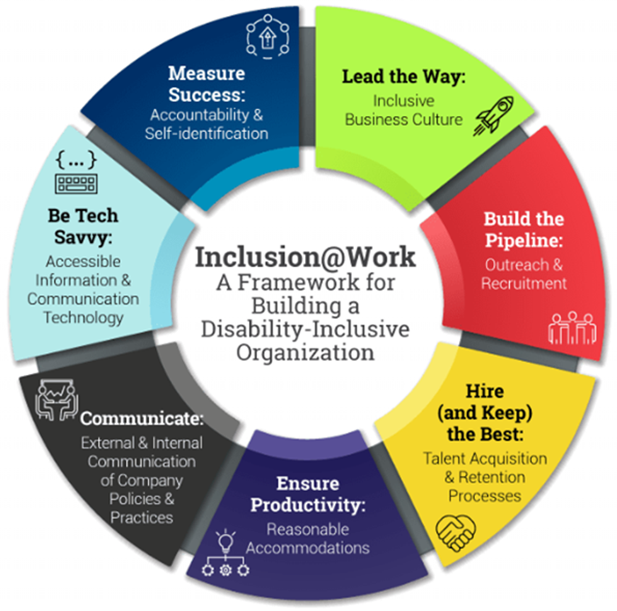
Inclusion @Work: Framework for Building a Disability Inclusive Organization askearn.org

Slide 12
Building Culture
Important considerations:
Demonstrate leadership commitment
Establish inclusion as a corporate value
Communicate commitment to inclusion

Slide 13
Outreach and Recruitment
Important considerations:
Establish effective outreach efforts
Develop relationships with recruitment source
Establish a pipeline of qualified candidates with disabilities at all levels

Slide 14
Hire and Retain the Best
Important considerations:
Ensure access to all aspects of hiring
Provide access to career development opportunities
Implement policies that support advancement and retention

Slide 15
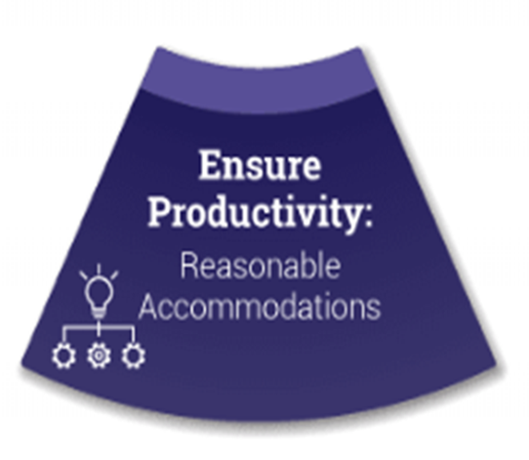
Productivity
Important consideration:
Ensure awareness of and access to reasonable accommodation

Slide 16
Communication
Important consideration:
Communicate policies internally and externally

Slide 17
Accessible Technology
Important considerations:
Ensure access to hiring systems
Ensure access to HR systems
Implement plans to procure and use accessible ICT

Slide 18
Collecting and Using Data
Important considerations:
Ensure access to training
Make data-informed decisions
Encourage self-identification

Slide 19
Self-Identification & Disclosure

Slide 20
What is Self-Identification?
Voluntary and confidential process by which people can notify their employer that they identify as a person with a disability
Used for data collection and reporting only

Slide 21
What is Disclosure?
Sharing information about disability for reasons other than self-identification
Accommodation request
Through an ERG
As part of company’s communication plan
Personal storytelling

Slide 22
The Choice to Self-Identify
Self-identification and disability disclosure are complex decisions!
Am I safe?
How will it impact:
My relationships?
My career growth?
People’s belief in my abilities?
How I’m treated at work?

Slide 23
The Benefit of Self-Identification
“Self-identification can provide organizations with information that can be leveraged to allocate resources and support to candidates who fall into an underrepresented category. The information can impact access to benefits, training and mentorship. Leaders can also use the data to help launch or expand D&I initiatives that can help enhance employee engagement and aid in retention efforts.”
Fullilove, 2022

Slide 24
Accommodation & Inclusion

Slide 25
Accommodation is a basic element of disability inclusion
What can employers do?
Inform everyone about accommodation policies and procedures
Create a safe space for self-identification and disclosure—How can I help?
Train human resources and people leaders to recognize and respond to accommodation requests and to be solution-focused
Be flexible and creative when exploring accommodations
Access resources to support the accommodation process (e.g., JAN, EARN, PEAT)

Slide 26
Inclusive Hiring and Accommodations
Inclusive hiring means that at every stage of the hiring process, candidates with disabilities have equal access.
Recruiting
Application
Interviewing
Testing
Onboarding

Slide 27
Processing Hiring Accommodation Requests
Include a reasonable accommodation statement. For example:
[Employer] is committed to the full inclusion of all qualified individuals. As part of this commitment, [Employer] will ensure that persons with disabilities are provided reasonable accommodations for the hiring process. If reasonable accommodation is needed, please contact [include name and/or department, telephone, and e-mail address, etc.].
Appoint someone to handle accommodation requests quickly
Aim to minimize the amount of personal medical information received about applicants and candidates

Slide 28
New Resources @ AskJAN.org
Hiring Process Reasonable Accommodation Flowchart
Sample Medical Inquiry Form in Response to an Accommodation Request for the Hiring Process
Sample Reasonable Accommodation Request Form for the Hiring Process
Sample Reasonable Accommodation Statements for the Hiring Process
Streamlining the Interactive Process When Accommodating Job Applicants

Slide 29
Resources @ AskEARN.org
Encouraging Applicants with Disabilities: Job Descriptions and Announcements
Accessible and Authentic Interviews for Candidates with Disabilities
Measure Success: Accountability & Self-Identification
Encouraging Self-Identification
Online Recruitment of and Outreach to People with Disabilities: Research-Based Practices

Slide 30
Technical Assistance centers
Employer Assistance and Resource Network on Disability Inclusion (EARN)
AskEARN.org
Job Accommodation Network (JAN)
AskJAN.org
Partnership on Employment and Accessible Technology (PEAT)
PEATWORKS.org

Slide 31
Questions?

Slide 32
JAN Accommodation and Compliance Webcast Series
Thank you for attending: “Building a Disability-Inclusive Organization”
Register for the next JAN webcast: AskJAN.org/events/register/2021-2022-webcast-series.cfm

Slide 33
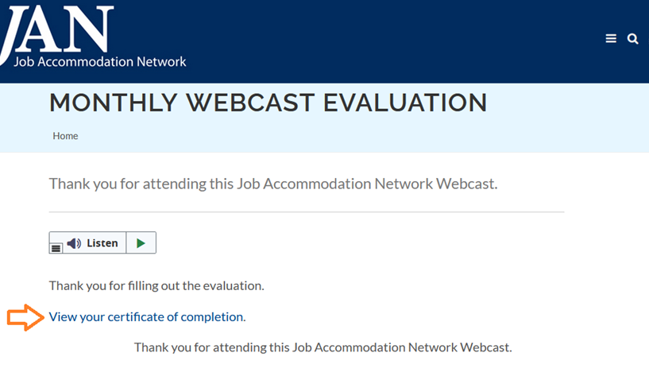
How do I claim the HR CEU?
Don’t close the JAN webcast browser
Complete the webcast evaluation in new window or go to: AskJAN.org/EvaluationReg.cfm
Click on View your certificate of completion

Slide 34
Questions? Contact JAN for More Information
34
Visit
AskJAN.org
Call
800.526.7234
877.781.9403 (TTY)
Chat
@ AskJAN.org
Submit
JAN on Demand Inquiry @ AskJAN.org/JANonDemand.cfm
Email
JAN@AskJAN.org
Social Media
Facebook – Job Accommodation Network Twitter – @JANatJAN

