Slide 1
Accommodation and Compliance Webcast Series: Accommodation solutions for Fine Motor Limitations
Matthew McCord, Senior Consultant, Motor Team Julie Davis, Consultant, Motor Team

Slide 2
Housekeeping
Technical Difficulties
Q&A option at the bottom of the screen
800-526-7234 or 877-781-9403 (TTY) or Live Chat at AskJAN.org
Frequently Asked Questions (FAQ) AskJAN.org/Training/JAN-Webcast-Frequently-Asked-Questions.cfm
Questions for Presenters
Q&A option at the bottom of the screen

Slide 3
Housekeeping 2
PPT Slides
Link to PPT is included in webcast login email, or see the link now in the chat, or go to this webcast event from the Training page at AskJAN.org
Captioning
Use the closed caption (CC) option or captioning link in the chat

Slide 4
Discussion Points
4
What is a fine motor limitation?
What are some common fine motor limitations?
What sort of accommodations can be helpful?
What does a real-life accommodation scenario look like?

Slide 5
About Fine motor Limitations
5
People with fine motor limitations have difficulty with manual dexterity due to underlying issues with nerves and muscles of the arm, hand, and fingers, as well as joints, tendons, and ligaments.
The repetition of small, rapid movements; working in a static and/or awkward posture for long periods of time; insufficient recovery time (too few rest breaks); improper workstation setup; forceful movements; excessive grasping; and poor work techniques may contribute to injury
Approximately 98.7% of civilian workers utilize fine motor skills in their work.
About 56% of occupational injuries are cumulative trauma-related.
US Bureau of Labor Statistics, Science Direct

Slide 6
Common Medical Conditions
6
Bursitis
Bursa (small fluid sack between joints) becomes inflamed resulting in pain
Carpal Tunnel Syndrome (CTS)
Results in pressure on the medial nerve from the forearm and fingers resulting in weakness, pain, difficulty holding items, and tingling
Cubital Tunnel Syndrome
Occurs when the ulnar nerve becomes compressed near the elbow causing numbness and pain

Slide 7
Common Medical Conditions 2
7
DeQuervain’s
Affects the tendons that run along the thumb side of the wrist. Symptoms include pain and tenderness on that side of the wrist.
Impingement Syndrome
Also known as rotator cuff syndrome, results from the tendons of the shoulder being pinched between the shoulder and upper arm causing pain in the shoulder area
Radial Tunnel Syndrome
Results from too much pressure on the radial nerve that causes pain and tenderness on the outside of the elbow radiating down the forearm and hand

Slide 8
Common Medical Conditions 3
8
Tendonitis
Occurs when there is inflammation of tendons at the point where a muscle attaches to the bone
Trigger Finger
A common condition caused by inflammation of the flexor tendons in the hand
Thoracic Outlet Syndrome
A condition characterized by pain in the neck, shoulders, and fingers and weakening of the grip

Slide 9
Limitations & Work
9
Pain/aching
Tenderness/swelling
Weakness of hands/arms
Tingling/numbness
Loss of joint movement
Decreased coordination

Slide 10
Accommodations: Keyboarding
10
Alternative Keyboards
Miniature Keyboards
One-Handed Keyboards
Keyguards
Speech Recognition Software

Slide 11
Scenario: keyboarding
11
Scenario
An employer contacted JAN seeking specific accommodation suggestions to help an individual with carpal tunnel syndrome. The individual needed to avoid specific repetitive movements in their right wrist and was seeking an alternative type of keyboard as an accommodation.

Slide 12
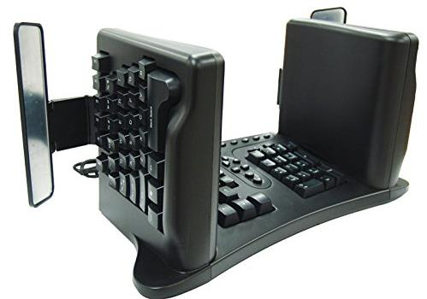
Solution: Keyboarding
12
Solution
JAN staff suggested a vertical keyboard to enable the individual to utilize different wrist movements when using their computer.

Slide 13
Accommodations: Mousing
13
Alternative Mice
Tremor-Limiting Mice
Head-Controlled Computer Input Devices
Eye-Controlled Computer Input Devices
Feet-Controlled Computer Input Devices

Slide 14
Scenario: Mousing
14
Scenario
An individual with fibromyalgia contacted JAN seeking accommodation options because clicking the computer mouse that they currently use at work caused them extreme pain. The individual mentioned that using ordinary pen and paper did not cause this pain.

Slide 15
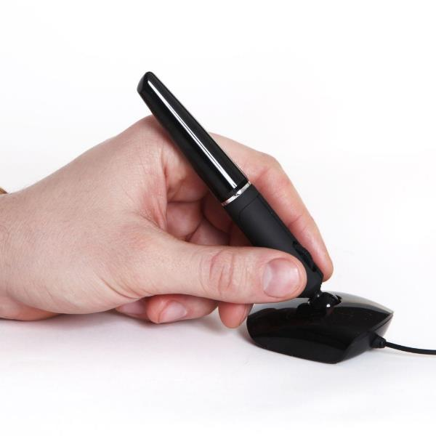
Solution: Mousing
15
Solution
A variety of computer mice held and used similarly to a pencil or pen were suggested.

Slide 16
Accommodations: Handwriting
16
Grip Aids
Weighted Writing Implements
Writing Aids
Writing Guides
Apps for Note Taking/Writing

Slide 17
Scenario: Handwriting
17
Scenario
An employee was expected to take handwritten notes during meetings and was having difficulty keeping up with the task.

Slide 18
Solution: Handwriting
18
Solution
A voice recorder was suggested for taking notes so the employee could listen and type notes later.

Slide 19
Accommodations: Gripping/Grasping
19
Anti-tremor/Anti-vibration gloves
Headsets
Motorized carts
Reachers
Steering grips

Slide 20
Accommodations: Gripping/Grasping 2
20
DIY Options
Air-drying clay
Pool noodle
Sponges
Medical bandages
Rubber bands
JAN article: Get A Grip! DIY & Practical Solutions for Gripping and Grasping

Slide 21
Scenario: Gripping/Grasping
21
Scenario
An employee had limitations in taking notes during interviews because of rheumatoid arthritis. After the employee disclosed their medical condition to the employer, they began the interactive process.

Slide 22
Solution: Gripping/Grasping
22
Solution
The employee opted to try molding clay as a gripper on the pen so she can create a mold to match her specific grip. Also, the employee requested 10-minute breaks in between interviews to allow a rest period for her hands.

Slide 23
Accommodations: Lifting/Carrying
23
Generalized Accommodations
Compact Material Handling Devices
Stairclimbing Handtrucks
Motorized Carts
Spring-Loaded Carts
Ball Transfer Tables

Slide 24
Accommodations: Lifting/Carrying 2
24
Specialized Accommodations
Hands-Free Resuscitation Devices
Manhole Cover Lifts
Compact Mobile Cranes
Walk-Up Changing Tables
Evacuation Devices

Slide 25
Scenario: Lifting/Carrying
25
Scenario
An employer contacted JAN seeking potential accommodation ideas for a candidate applying for a truck driver position. The candidate had limited use of one of their arms, and the employer thought lifting and pulling the moving dolly in the truck would be challenging for this individual.

Slide 26
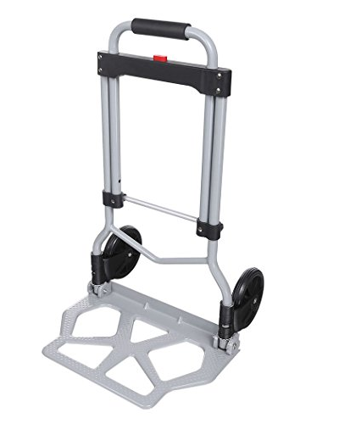
Solution: Lifting/Carrying
26
Solution
JAN staff suggested replacing the existing dolly with a lightweight model. Most standard dollies weigh around 25-30 pounds, but the suggested option weighed around 10 pounds due to being made from aluminum.

Slide 27
Accommodations: fatigue
27
Anti-Fatigue Matting
Wearable Anti-Fatigue Matting
Stand-Lean Stools
Flexible Scheduling
Telework

Slide 28
Scenario: fatigue
28
Scenario
An employee who worked in a battery manufacturing plant was on leave and contacted JAN seeking accommodation ideas to help manage their fatigue.

Slide 29
Scenario: fatigue 2
29
Solution
This individual contracted COVID-19 twice the year prior to contacting JAN and hasn’t been able to get their stamina back to normal levels. They have been on leave ever since.
Due to the length of time the individual has been on leave and how their symptoms have not improved in that time, JAN staff suggested reassignment to a less physically demanding position as an accommodation.

Slide 30
Accommodations: Ergonomic Workstations
30
Articulating Keyboard Trays
Book Holders
Gooseneck and other Telephone Holders
Hands-Free Telephones
Touchless Faucets

Slide 31
Scenario: Ergonomic Workstations
31
Scenario
A Return-to-Work Coordinator contacted JAN for accommodation ideas for an employee with a pinched nerve in their left shoulder. The employee reported pain when holding the desk phone handset while also typing simultaneously. The employee also could not use a typical headset.

Slide 32
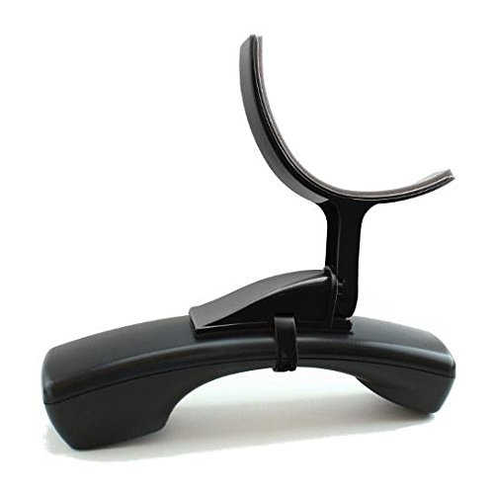
Solution: Ergonomic Workstations
32
Solution
JAN staff suggested providing the individual with a telephone handset with a shoulder rest attached. This way the shoulder would not be flexed to keep the handset in place.

Slide 33
Accommodations: PAIN
33
Modified Break Schedule
Flexible Schedule
Temperature Concerns
Telework

Slide 34
Scenario: Pain
34
Scenario
An employee with tendonitis was experiencing pain when completing typing tasks and was seeking accommodations to reduce the pain they were experiencing.

Slide 35
Solution: Pain
35
Solution
JAN suggested speech recognition software and alternative input devices to reduce pain and enable the employee to complete essential job functions.

Slide 36
Accommodations: HANDLING/Fingerling
36
Doorknob Grips and Handles
Smart Locks/Keyless Entry
Hands-Free/Foot-Pull Door Openers
Automatic Door Openers
Forearm Supports

Slide 37
Scenario: HANDLING/Fingerling
37
Scenario
An employer was looking for accommodations for a pharmacist who was having difficulty handling and cutting pills for prescriptions. The employee needed a solution that would be quicker than using an ordinary pill cutter.

Slide 38
Solution: HANDLING/Fingerling
38
Solution
A multiple pill splitter with wells was suggested. This would enable the pharmacist to place the pills in the cutter without dropping them and to cut several pills at once without slowing down productivity.

Slide 39
Accommodations: Feeling/Sensing
39
Periodic Rest Breaks
Heated Ergonomic Computer Products
Alternate Between Tasks
Job Restructuring

Slide 40
Scenario: Feeling/Sensing
40
Scenario
An employee who works in a call center had to do data entry which was causing lack of feeling and sensing in the fingers.

Slide 41
Solution: Feeling/Sensing
41
Solution
JAN suggested that the employee request periodic rest breaks when lack of feeling was an issue along with the use of alternative input devices and speech recognition software.

Slide 42
Questions?
42

Slide 43
Thank you for attending “Accommodation solutions for Fine Motor Limitations”
43
Next JAN Webcast: “What to Do When Performance and Conduct Factor Into the Accommodation Equation” Thursday, June 8 @ 2:00 p.m. ET
JAN Training Events & Resources AskJAN.org/Events/Trainings.cfm

Slide 44
How do I claim the HR CEU? Complete the Evaluation
44
Don’t close the JAN webcast window
Evaluation will open in a new window
Complete the evaluation and click on “View your certificate of completion.”
Or go to AskJAN.org/EvaluationReg.cfm
Or scan the QR code

Slide 45
Contact JAN for More Information
45
Visit
AskJAN.org
Call
800.526.7234
877.781.9403 (TTY)
Live Chat
@ AskJAN.org
Email
JAN@AskJAN.org
Social Media
Facebook – Job Accommodation Network Twitter – @JANatJAN

