Slide 1
Accessibility & Accommodations
How employers and HR professionals can
prepare for emerging tech in the workplace
May 20, 2021

Slide 2
Housekeeping
Technical Difficulties
  Use the Q&A option at the bottom of the screen
  OR Live Chat at AskJAN.org
Questions for Presenters
  Use the Q&A option at the bottom of the screen
PPT Slides
  See the link included in the chat or download from the Webcast Archive page
Captioning
  Use the closed caption option at the bottom of the screen or see the link included in the chat
Please complete the evaluation. THANK YOU!

Slide 3

Welcome
Happy Global Accessibility Awareness Day!
Learn more: GlobalAccessibilityAwarenessDay.org

Slide 4

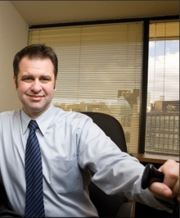
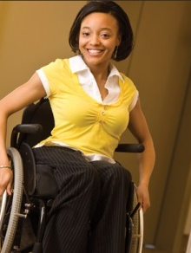
Job Accommodation Network
Consultation
All Things Job Accommodations
  All industries
  All job categories
  All impairments
Employment Legislation
  Americans with Disabilities Act
  Rehabilitation Act
AskJAN.org

Slide 5


PEAT’s Mission & Vision
Building the Future of Work
PEAT fosters collaborations in the technology space that build inclusive workplaces for people with disabilities.
Our vision is a future where new and emerging technologies are accessible to the workforce by design.
PEATworks.org/

Slide 6

Inclusive Tech & Employment
A McKinsey report found that, in 2020, the move to virtual work accelerated rapidly; the tools behind the virtual workplace are increasingly powered by emerging tech like AI and XR.
.
33.2% of adult job seekers with disabilities are employed, compared to 76.6% without disabilities.
Reference: McKinsey Global Institute, The Future of Work After COVID-19, February 18, 2021
Notes:
33.2% of adult job seekers with disabilities are employed, compared to 76.6% without disabilities.
This is a staggering gap in workforce participation that inclusive technologies can help close.
In 2020, the move to virtual work accelerated rapidly.
McKinsey reported adoption of digital tech sped up by several years in just 8 months—many of changes are likely permanent.
Tools behind virtual work are also increasingly powered by new and emerging technologies like AI and Extended Reality

Slide 7
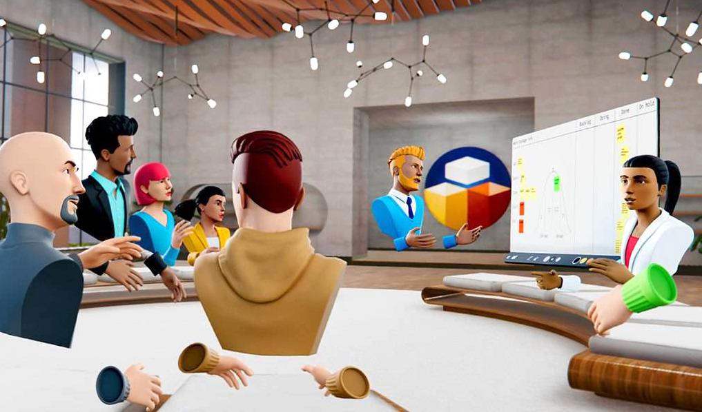
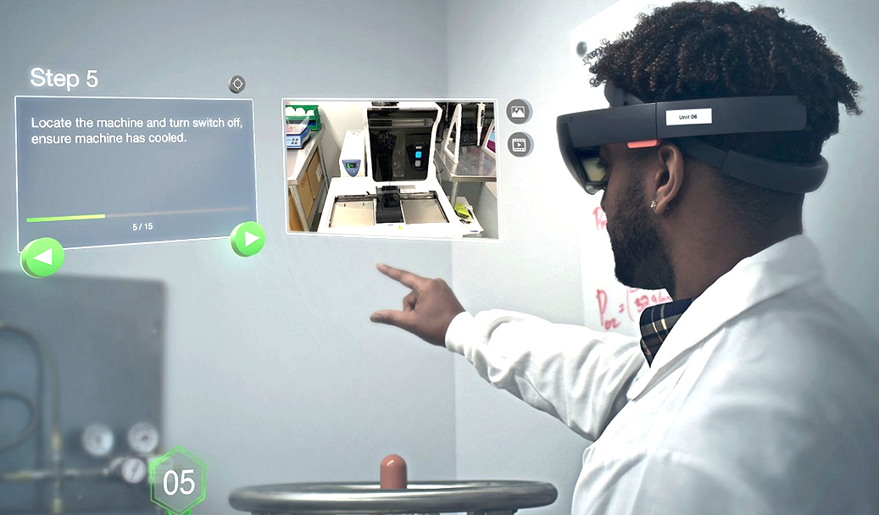
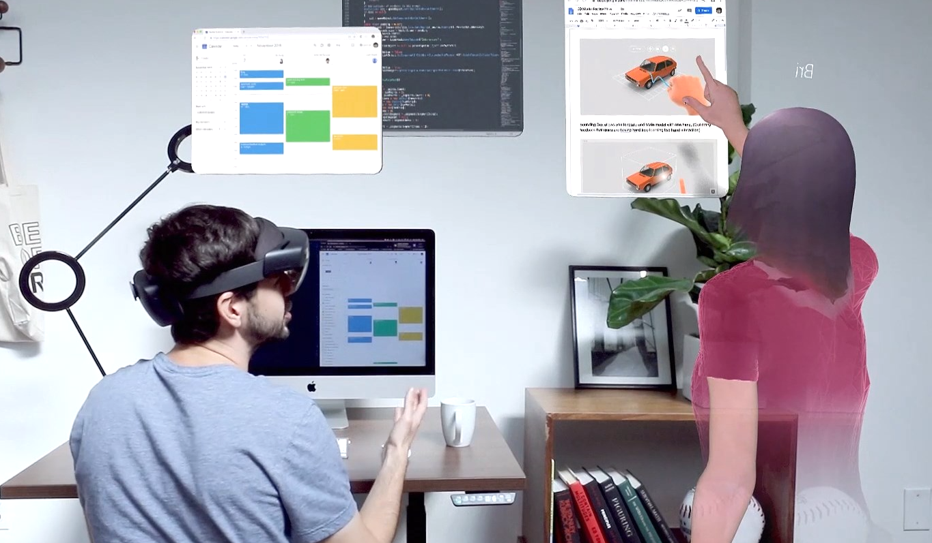
What is Extended Reality (XR)?
.
Virtual Reality (VR)
Augmented Reality (AR)
Mixed Reality
Fully digitally-generated immersive experiences, accessed via head-mounted displays or via a web browser.
Digitally-augmented experiences rendered as an overlay on the user’s field of view, accessed via head-mounted displays or via a web browser.
Merging the physical and digital worlds to produce experiences where physical and digital objects, and users, co-exist in 3D space.
Photo credits: Glue (Virtual Reality), Global Foundries/PTC (Augmented Reality), Spatial.io (Mixed Reality)

Slide 8









Accessibility in XR
.
Core XR HW/SW Platform Accessibility
Making core XR hardware, platform software and embedded operating system-level apps accessible.
Exploring and advancing both dimensions to advance the overall possibilities of XR Accessibility.
Inclusive Co-Design
XR As Assistive Technology
Building XR-enabled assistive tech to improve access by people with disabilities.
Icon credits: Freepik, Nikita Golubev, Smashicons (FlatIcons.com)

Slide 9

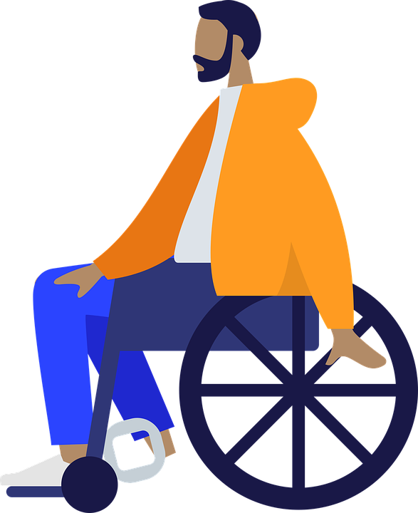
AI in Current & Future Workplaces
Job searching and finding work
Recruiting talent, screening interviewing, hiring
Onboarding, training, and development
Physical site navigation
Communication, collaboration, and productivity
Personalized accommodations / assistive technology
Health, wellness, and safety
Work optimization, performance evaluation, and promotions
Digital assistants

Slide 10

AI Fairness - People w/ Disabilities
Researcher Meredith Ringel Morris outlined 7 challenges related to AI fairness for people with disabilities
Inclusive Design
Bias Prevention
Data Privacy
Errors & Trust
Expectation Setting
Simulated vs. Inclusive Data Sets
Social Acceptability
Source: Communications of the ACM, Vol. 63 No. 6, June 2020
Notes:
Inclusivity – Has the tech been designed in an inclusive way and is it effective for diverse user populations?
Bias – Does the tech exacerbate disability-based discrimination?
Privacy – Are the privacy risks for people with disabilities amplified by the tech?
Error – Can people with disabilities trust the tech, rely on the error metrics used?
Expectation Setting – Have unreasonable expectations been set for the tech?
Simulated Data – Has the use of simulated data been avoided, instead using inclusive data sets that better represent people with disabilities?
Social Acceptability – What is socially acceptable to people with disabilities?

Slide 11


XR Accessibility Perspective
Martez E. Mott, Ph.D.
Senior Researcher, Ability Group
Microsoft Research

Slide 12


AI Accessibility Perspective
Tina M. Park, Ph.D.
Methods for Inclusion Research Fellow
Partnership on AI

Slide 13


Questions & Answers
Anne Hirsh
Bill Curtis-Davidson
Martez E. Mott, Ph.D.
Tina M. Park, Ph.D.
Use Zoom’s Q&A feature to send questions to speakers
  We’ll answer many of them during the last part of the webinar
  We’ll follow up after the webinar for unanswered questions

Slide 14
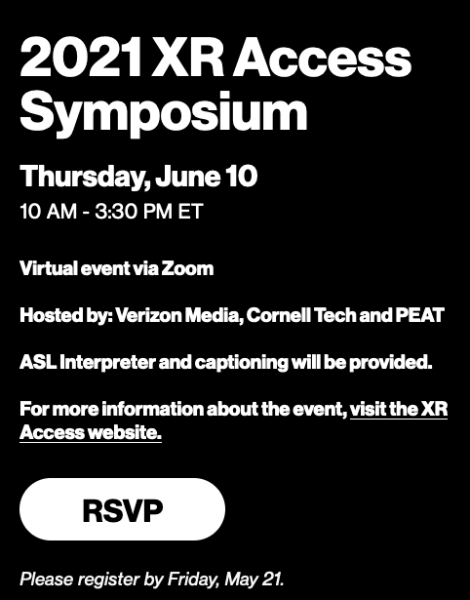
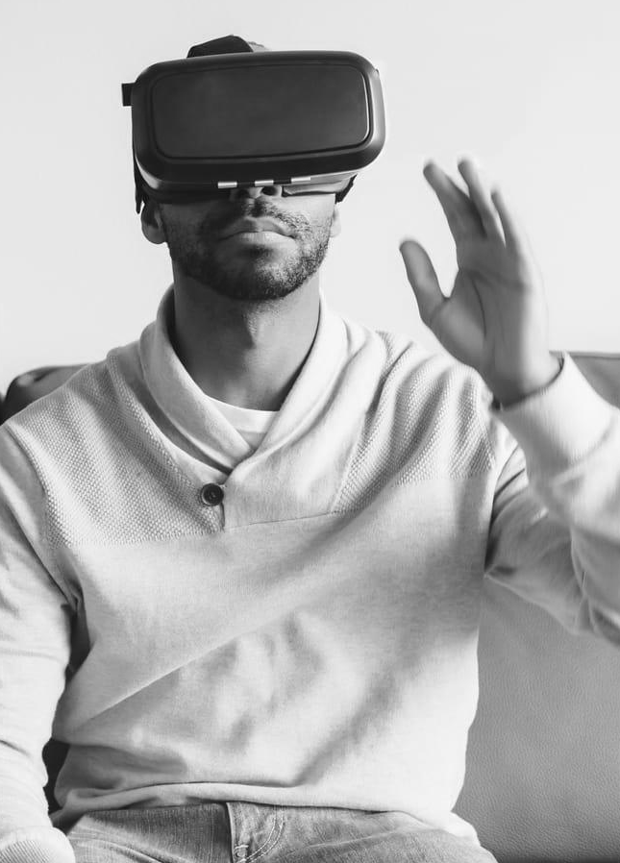

PEAT Resources
PEAT Future of Work Resources
  Main website (peatworks.org/futureofwork)
  Podcasts (peatworks.org/futureofwork/future-of-work-podcast/)
XR Access Initiative (xraccess.org/)
Partnership on AI (partnershiponai.org)
Email: info@peatworks.org
Coming Soon (Summer 2021):
PEAT Equitable AI Toolkit for Employers
Register (Free/Virtual): www.xraccess.org/symposium

Slide 15
Contact JAN
Visit AskJAN.org
Submit a JAN on Demand question @
AskJAN.org/JANonDemand.cfm
Email JAN @ jan@askjan.org
Use the JAN Live Chat @ AskJAN.org
Leave a voicemail message.
JAN staff will contact you via email or a call:
  800.526.7234 (V)
  877.781.9403 (TTY)
Please complete the evaluation. THANK YOU!

