Slide 1
ATIA 2023 Conference
January 25 to 27, 2024
Orlando, FL + Virtual

Slide 2
Back on Track with the Interactive Process: When Accommodations
Go Off the Rails
TWA-02
Teresa Goddard
Lisa Mathess
Job Accommodation Network
AskJAN.org
1-800-526-7234

Slide 3
Speaker Disclosure
Teresa Goddard has financial and non-financial relationships to disclose. [employment salary & ATIA strand advisor]
Lisa Mathess has financial relationships to disclose. [employment salary]

Slide 4
Learning Objectives
Participants will identify two features of sufficient medical documentation.
Participants will participate in a guided discussion to identify accommodation options for three workplace accommodation scenarios.
Participate in a guided demonstration of JAN’s A to Z Lists at https://AskJAN.org/A-to-Z.cfm and use this resource to identify three accommodation solutions.

Slide 5
Session Evaluation and CEUs
Session Feedback Evaluation
Your Feedback is very important to us. Please be sure to complete session evaluations through the ATIA mobile app.
CEUs
ATIA 2024 education sessions are reviewed for ACVREP, AOTA, ASHA, CRC and IACET CE eligibility. Not all sessions are approved for each specialty CEU. Please see each session description for CEU availability.
Full information: atia.org/atia-2024-orlando-ceus

Slide 6

Ask JAN! We Can Help
Job Accommodation Network (JAN) was established in 1983
National, free consulting service
A service of the U.S. Department
of Labor’s Office of Disability Employment Policy/ODEP
Practical guidance and technical assistance for employers, people
with disabilities, and others on:
Accommodation process strategies
Job accommodation solutions
Title I of the ADA and related legislation
Self-employment and entrepreneurship options for people with disabilities

Slide 7

Interactive Process

Slide 8

Reasonable Accommodation
A change or adjustment to a job or work environment that permits a qualified individual with a disability to:
  access the application process
  perform essential functions of a job
  enjoy equal benefits and privileges
Reasonable means “feasible” or “plausible” — possible to provide without undue hardship
Undue hardship — an action requiring
significant difficulty or expense
Must be effective for the purpose

Slide 9
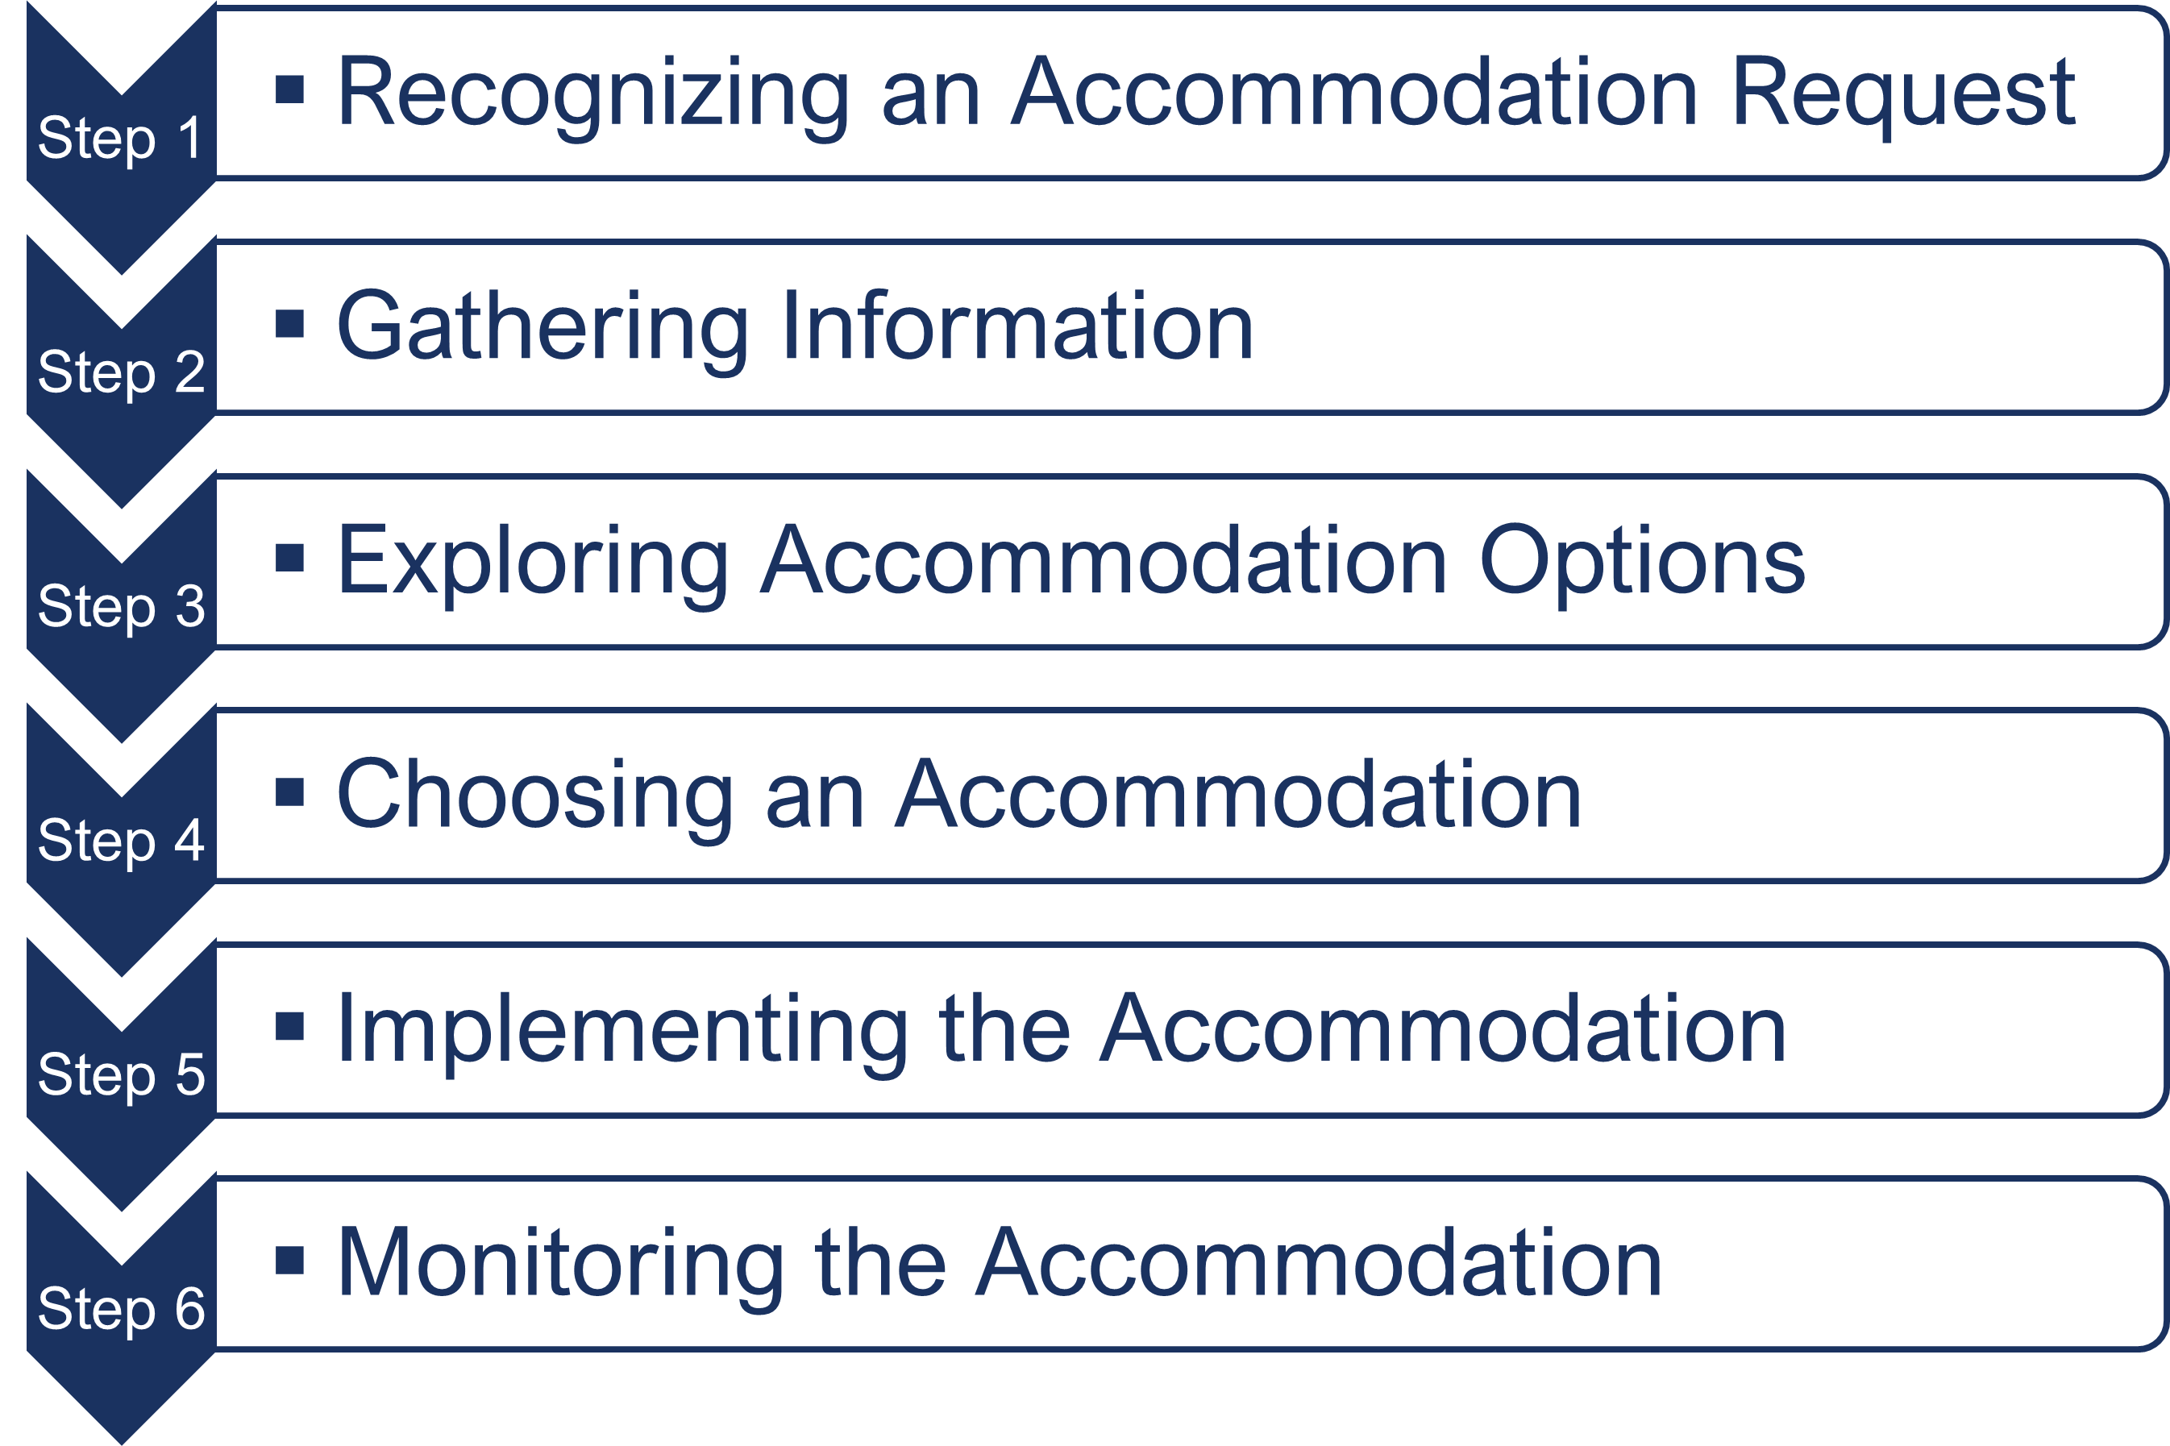
Interactive Process
A process for collaboratively identifying accommodation solutions
AskJAN.org A to Z Topic: Interactive Process

Slide 10
Step 1 — Train Frontline to Recognize Accommodation Requests
Any request by an applicant or employee for an adjustment or change for a reason related to a medical condition is an ADA accommodation request
  “I am neurodiverse and need interview questions in advance.”
  “I'm having difficulty concentrating because of the side effects of new medication.”
  An employee says their wheelchair won’t fit under their desk
  A note from a healthcare provider indicates the need for 3 months of leave for medical treatment
  “I need to go to counseling appointments once a week and would like to flex my schedule those days.”
Accommodation request =
impairment causing a problem + work-related barrier

Slide 11

Step 1 —Recognize Requests Example
Sam experiences severe migraines triggered by workplace noise and overhead fluorescent lighting. Sam asked their manager whether they could wear noise-canceling earbuds and turn off the lights above their workstation.
The manager said they needed to check with human resources, but after three weeks Sam did not receive follow-up from the manager, and no changes were made. Sam continued to experience migraines, which impacted their attendance and performance.

Slide 12

Step 1 — Pro Tip: Facilitate the Accommodation Conversation
Not sure if it’s an accommodation request?
Ask.
Examples:
  “How can I help?”
  “I want to clarify what you’re asking for and why it’s needed, so I can find out what we can do to help.”
  “Are you asking for an accommodation?”
Recognizing an Accommodation Request
Mother May I? Must I? Should I?
How Can I Help?

Slide 13
Step 2 — Gathering Information
Pro Tip: Request Only Necessary Medical Information
What’s the objective?
To establish impairment and limitations
To understand the impact of the impairment and limitations on employee and work
To support the need for accommodation
To learn about ability to return to work
To evaluate fitness for duty
To analyze safety/direct threat
Requests should be well designed and purposeful.
  A Flexible Approach to ADA Medical Documentation
  Requests for Medical Documentation and the ADA
  To Ask, or Not to Ask? – Knowing When to Request Medical Information

Slide 14
Sufficient Medical Documentation
Reasonable and sufficient documentation
Sufficient documentation substantiates disability and need for accommodation:
  Whether the individual has (or had) an impairment
  Whether the impairment affects (or affected) a major life activity
  Whether the impairment substantially limits (or limited) the major life activity
  What limitations are causing the problem
  Whether/what accommodation(s) is needed
  What Does "Sufficient" Mean?- A Deconstructive Series for ADA Terminology
  Medical Inquiry in Response to an Accommodation Request and Sample Form

Slide 15
Flexible Approach to ADA Medical Documentation
Allow medical documentation extension(s) when feasible
Rely on information from the employee and provide temporary accommodations while waiting for medical documentation
Partner with the employee to explore solutions
Forgo medical documentation when possible
A Flexible Approach to ADA Medical Documentation
Providing Temporary Accommodation Solutions

Slide 16




Step 3 — Exploring Accommodation Options
Keep an open mind
Individuals should feel welcome to suggest options
Consult with service providers
Use JAN

Slide 17

Step 3 —
Pro Tip: Don’t Use a One-Size-Fits-All Approach
Have the full accommodation conversation
Impairments and limitations, as well as accommodation needs, are different based on the individual
Beware of any assumptions in determining what an individual can or cannot do or what accommodation is needed
Make individualized assessments based on actual limitations, work history, and current ability to perform job functions with accommodation

Slide 18




Step 4 — Choosing An Accommodation
Consider employee’s preference
Consider a trial period
The employer ultimately gets to choose the accommodation
Keep lines of communication open

Slide 19

Step 4 —
Pro Tip: Provide Interim, Temporary, and Trial Accommodations
Consider providing trial and short-term solutions
Might demonstrate whether the accommodation will be effective
Could enable an employee to return to work sooner than anticipated
Shows good faith effort and keeps employee working/expedites return to work
Temporary or Trial Accommodations

Slide 20
Step 4 — Choosing An Accommodation Example
An attorney with a severe visual disability requested a qualified reader. The employer instead provided a magnifier to allow the employee to read independently. However, reading with the magnifier was very slow to the point of being ineffective. The magnifier did not allow the employee an equal opportunity to compete for promotions.
Accommodations need to be effective
Consider employee preference
Get feedback from employee about effectiveness
Reconsider when appropriate
How to Inform an Employer That an Accommodation is Not Effective and a Sample Letter (JAN)
Based on example from EEOC Reasonable Accommodation & Undue Hardship Q.9

Slide 21



Step 4 — Pro Tip:
Consider Outside Agencies
Accommodation and Compliance: Assistive Technology (AT) (JAN)
State Vocational Rehabilitation Agencies (JAN)

Slide 22



Step 5 — Implementing the Accommodation
Ensure all necessary steps were taken to implement the accommodation
Only essential personnel should be informed about the accommodation
A point of contact should be established

Slide 23
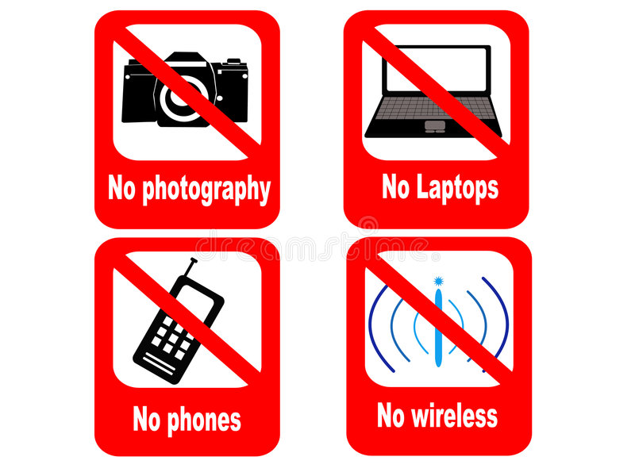
Step 5 — Implementing the Accommodation Example (1)
A new hire with Bluetooth-enabled hearing aids works in a secure facility, which prohibits wireless devices
The employer has determined that the device recommended by the audiologist for use in meetings, face-to-face conversations, and for telephone access cannot be permitted due to their policy against wireless devices.
Could the policy be modified?

Slide 24

Step 5 — Implementing the Accommodation Example (2)
The employer was unable to modify their security policy to allow the devices.
The employee is also willing to work from home and use their own devices, but because the work is Top Secret, it cannot be performed outside of the secure facility or at home.
The open cubicle environment continues to pose significant communication challenges.

Slide 25

Step 5 — Implementing the Accommodation Example (3)
The employer worked with the audiologist and a hearing aid company to determine whether there was a hearing aid accessory that would meet their security needs.
They also asked the employee for their ideas on what else may be able to help them.

Slide 26

Step 5 — Implementing the Accommodation Example (4)
If a private office is not available, consider installing noise abatement material such as soundproofing panels and relocate the workspace away from high traffic areas and equipment noise.
Depending on the nature and degree of hearing loss, telephone amplification or alternate equipment such as a neck loop may also be an option.
*For an existing employee, reassignment may have been an option.

Slide 27

Step 5 — Pro Tip: Open Communication
Maintain confidentiality
Remember ADA confidentiality rules
Policy Conflicts
IT
  Security
  Compatibility
Procurement
Union involvement
HIPAA/ OSHA

Slide 28

Step 6 — Monitor Accommodations
Monitor accommodations for effectiveness after implementation
Encourage ongoing communication
Maintain, update, replace equipment, provide training, and implement adjustments as needed
Don’t request new medical information to provide additional accommodations related to the same medical condition or maintain existing accommodations unless absolutely necessary
Sample Form for Monitoring Accommodations

Slide 29
Step 6 —Monitor Accommodation Examples
Jovie was approved to wear earbuds as an accommodation to help reduce distractions and improve focus and productivity. Medical documentation shows Jovie’s health condition is ongoing and the accommodation need is indefinite, but the employer requires a new medical note every six months.
Greenway Press is trying to reduce telework and get employees back to the workplace. To do so, it is implementing routine updates of medical documentation to recertify the ongoing need for previously approved telework accommodations.
Recertifying the Ongoing Need for Accommodation (JAN)

Slide 30

Additional Considerations

Slide 31
Transition Planning
Coordinate with teachers, therapists, etc.
Teamwork makes the dream work!
Talk with students to understand their needs and get ideas
Consider student’s learning style i.e., video vs written instruction
Educate on differences between school and workplace
Encourage student to take ownership!

Slide 32

Student Resources for Self-Advocacy
Contact JAN
Disability Disclosure Topics
How to Request an Accommodation: Accommodation Form Letter
How to Inform an Employer That an Accommodation is Not Effective and Sample Letter (JAN)

Slide 33
Integrating Assistive Technologies into
Existing Workflows (1)
Common issue in the workplace: Employees with Bluetooth-enabled hearing device (hearing aids or cochlear implants) need phone accessibility.
A typical approach is not to seek a Bluetooth headset but rather an alternate means of connecting to the phone.
One solution is the sound from the phone being sent wirelessly into the hearing aid or cochlear implant to be amplified according to the treating audiologist's chosen settings.
This approach may require a Bluetooth streaming device that connects to the hearing aid or implant via Bluetooth, and a telephone accessory or adaptor to connect the streaming device to the phone. The streaming device usually has a built-in microphone so that it can pick up the sound of the user's voice and send it to the phone via an accessory or adaptor. It also receives sound and sends it wirelessly to the user's hearing aid or cochlear implant.

Slide 34
Integrating Assistive Technologies into
Existing Workflows (2)
A natural gas worker was hard of hearing and the company had department wide daily meetings in the main large facility area. Typically, the employee would stand in the huddle formation, near the supervisor who was giving daily directions to ensure they could hear the information. This was effective, but the employee was uncomfortable.
The employer provided a tablet with an automated captioning app installed. This enabled the employee to stand anywhere in the huddle and receive captions in real time on the tablet. This allowed the employee a greater sense of independence and freedom of movement.

Slide 35
Interactive Process- Key Takeaways
Inform everyone about accommodation policies and procedures
Create a safe space for self-identification and disclosure—“How can I help?”
Recognize what you don’t know and gather reasonable information to explore, choose, and implement effective accommodation solutions
Make decisions that are job-related and consistent with business necessity
Train human resources personnel and people leaders to recognize and respond to accommodation requests and to be solution-focused
Be flexible and creative when exploring accommodations
Access resources to support the accommodation process
(e.g., JAN, VR, State AT)

Slide 36

JAN Website Tour

Slide 37
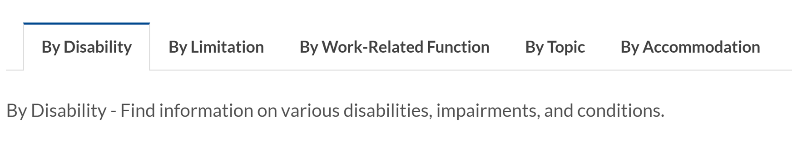
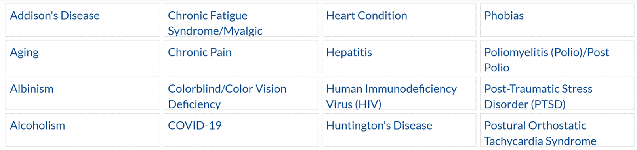
AskJAN.org A to Z
A to Z of Disabilities and Accommodations

Slide 38
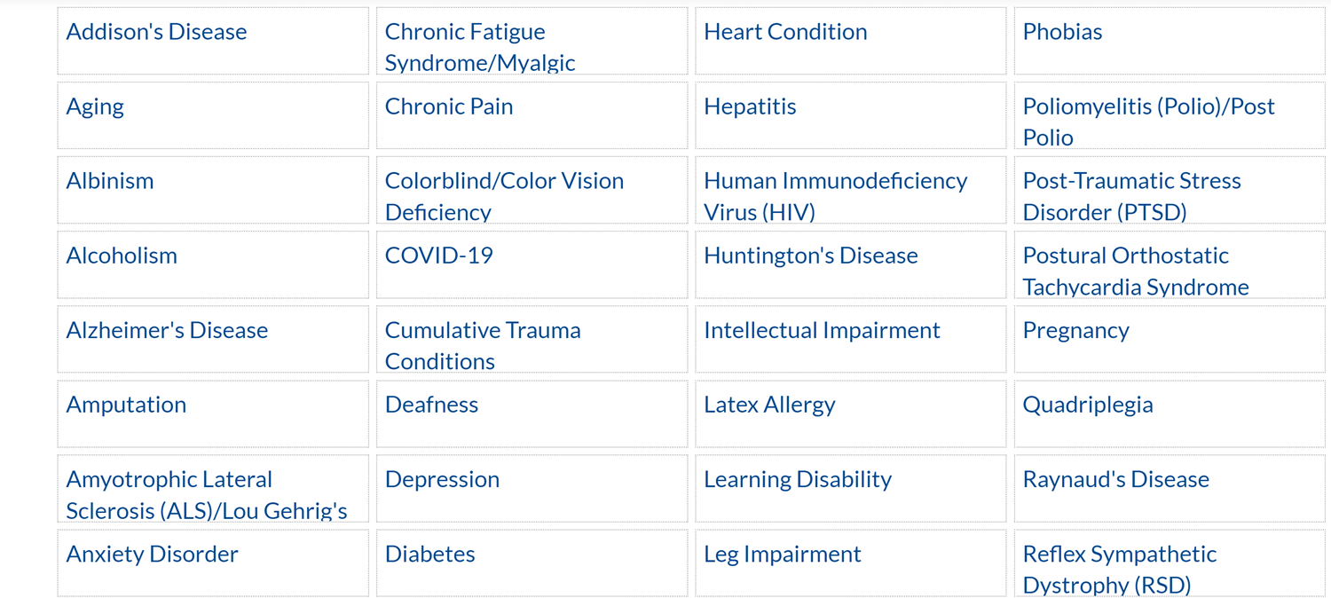
AskJAN.org by Disability

Slide 39
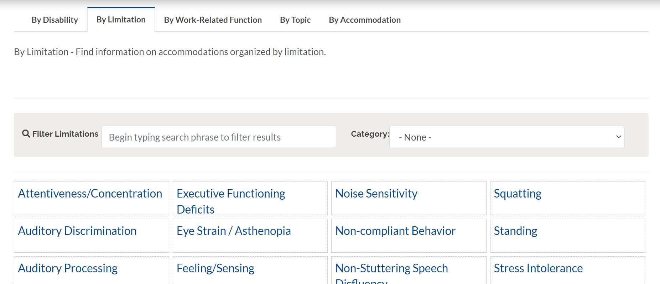
AskJAN.org by Limitation

Slide 40
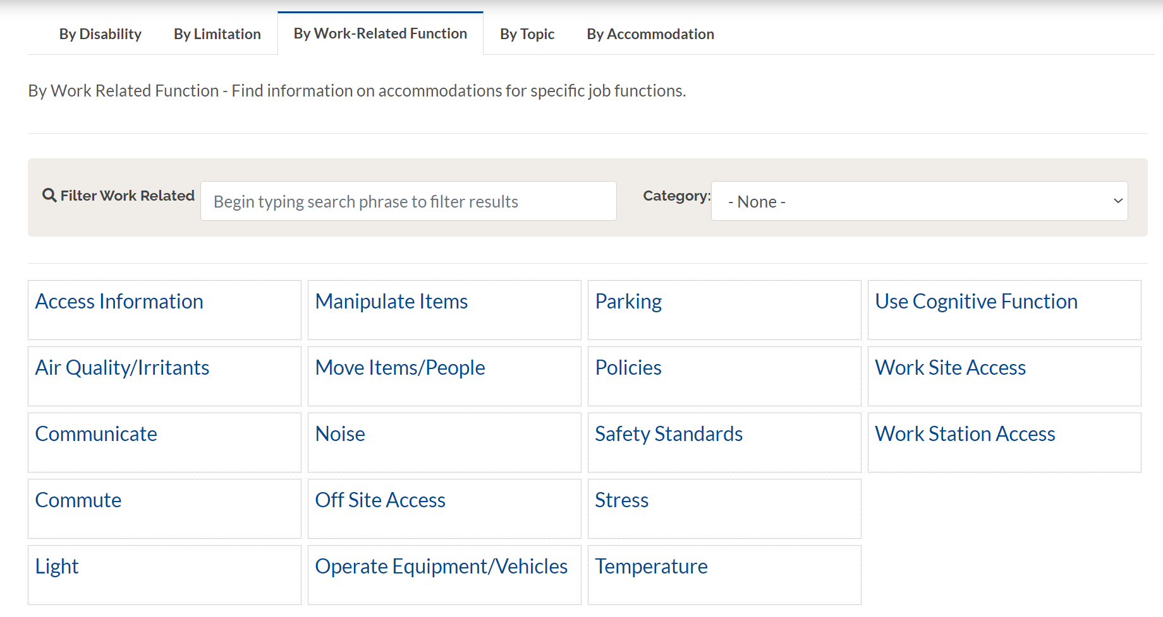
AskJAN.org by Work-Related Function

Slide 41
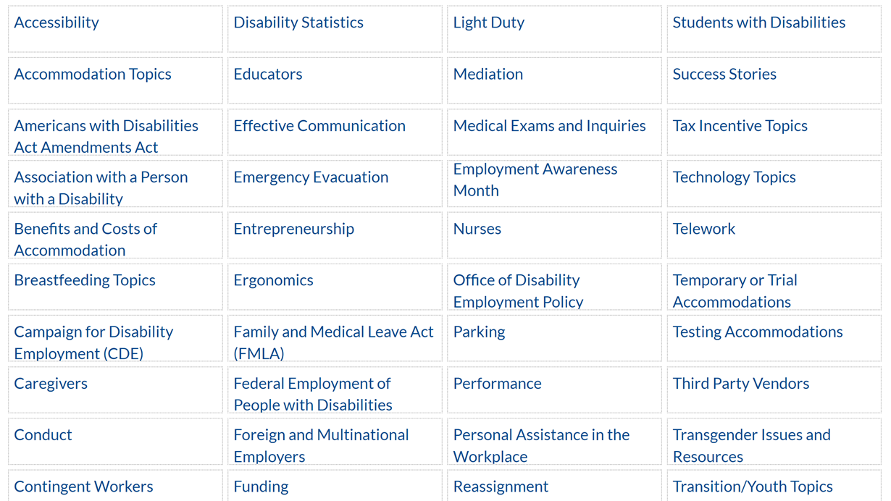
AskJAN.org by Topic

Slide 42
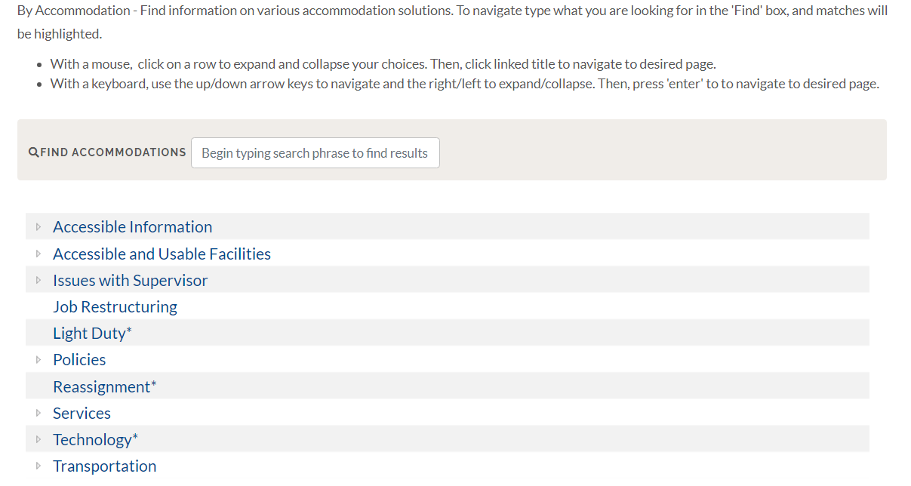
AskJAN.org by Accommodation

Slide 43
Questions
Questions

Slide 44




Ask JAN! We can help.
AskJAN.org
800.526.7234
Live Chat @ AskJAN.org
Email JAN@AskJAN.org

Slide 45

JAN Resources
Accommodation and Compliance Series: Interactive Process
Cognitive Impairment and the Interactive Process
Engaging in the Interactive Process During the COVID-19 Pandemic
The Interactive Process and
Service Providers
Streamlining the Interactive Process When Accommodating Job Applicants
New JAN Accommodation and Compliance Series Training Video Released: Medical Information and the Interactive Process
How to Request an Accommodation: Accommodation Form Letter
Your Accommodation Request Was Denied. What Now?

Slide 46
Thank You
Thank You

